Slide 1

VSC HPC Introduction
ICTS KU Leuven VSC staff: Mag Selwa Ehsan Moravveji
Wouter van Assche Geert Jan Bex (UHasselt) Jan Ooghe

Slide 2

What is High Performance Computing?
Using supercomputers to solve advanced computation problems
Reduce the computation time from days, years, decades, or centuries to minutes, hours, days, or weeks
The key is parallelism
Access to specialized hardware (GPU, large memory, high-speed interconnect)
Notes:
HPC is about techniques of boosting the efficiency of your codes and computation to enhance the compute performance as compared with a similar workflow on a typical laptop or workstation.

Slide 3

In practice, it is more like …
The concept is simple: Parallelism = employing multiple processors for a single problem
Notes:
In practice, there is a pool of computing resources made available to you which are waiting to receive instructions from the user. The nodes are all inter-connected, which means you can employ more than one node in a specific compute task, and the nodes within the task can communicate with one another at runtime, whenever needed.

Slide 4




















VSC PARTNERSHIP
A n t w e r p e n
O o s t
V l a a n d e r e n
Supported by
W e s t
V l a a n d e r e n
L i m b u r g
V l a a m s - B r a b a n t
B r u s s e l
vscentrum.be
4
Notes:
VSC is a partnership between 5 major universities and associations in Flanders, namely … and is spread among 4 sites. VSC is sponsored by the flemish research organization FWO. The idea is that the academics (scientists, students) and industrial partners in Flanders have an easy access to compute and storage facilities. Hence any individual with a single VSC account is eligible to compute on any cluster/site that he/she deires

Slide 5

Surf to: www.vscentrum.be
Very rich suite of courses every academic year
Documentation! Answers >80% of your questions and access to account page

Slide 6
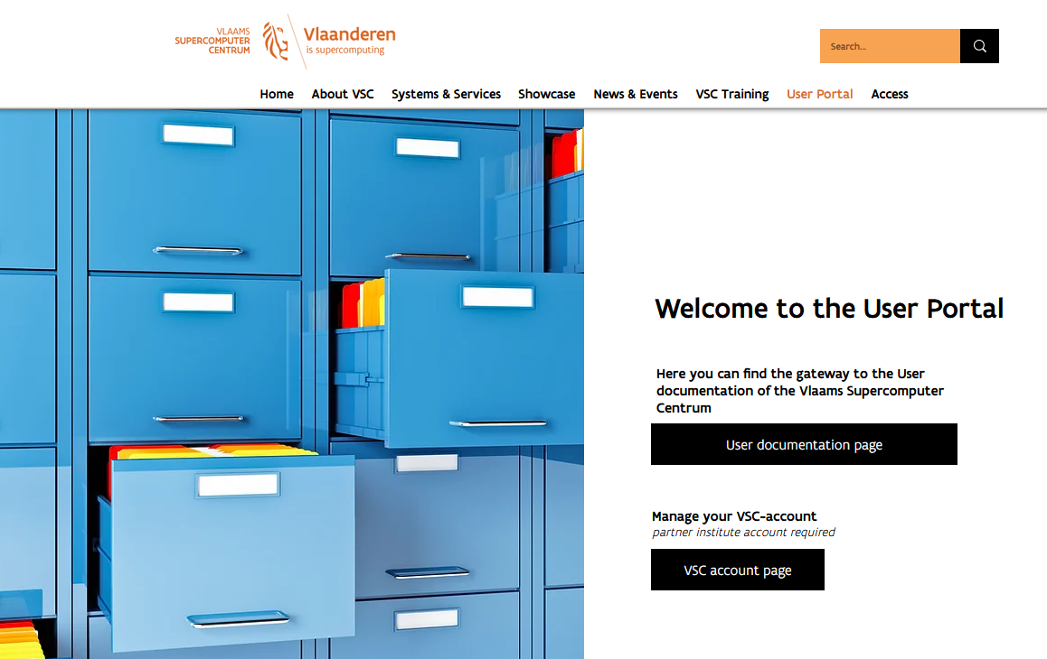
6

Slide 7
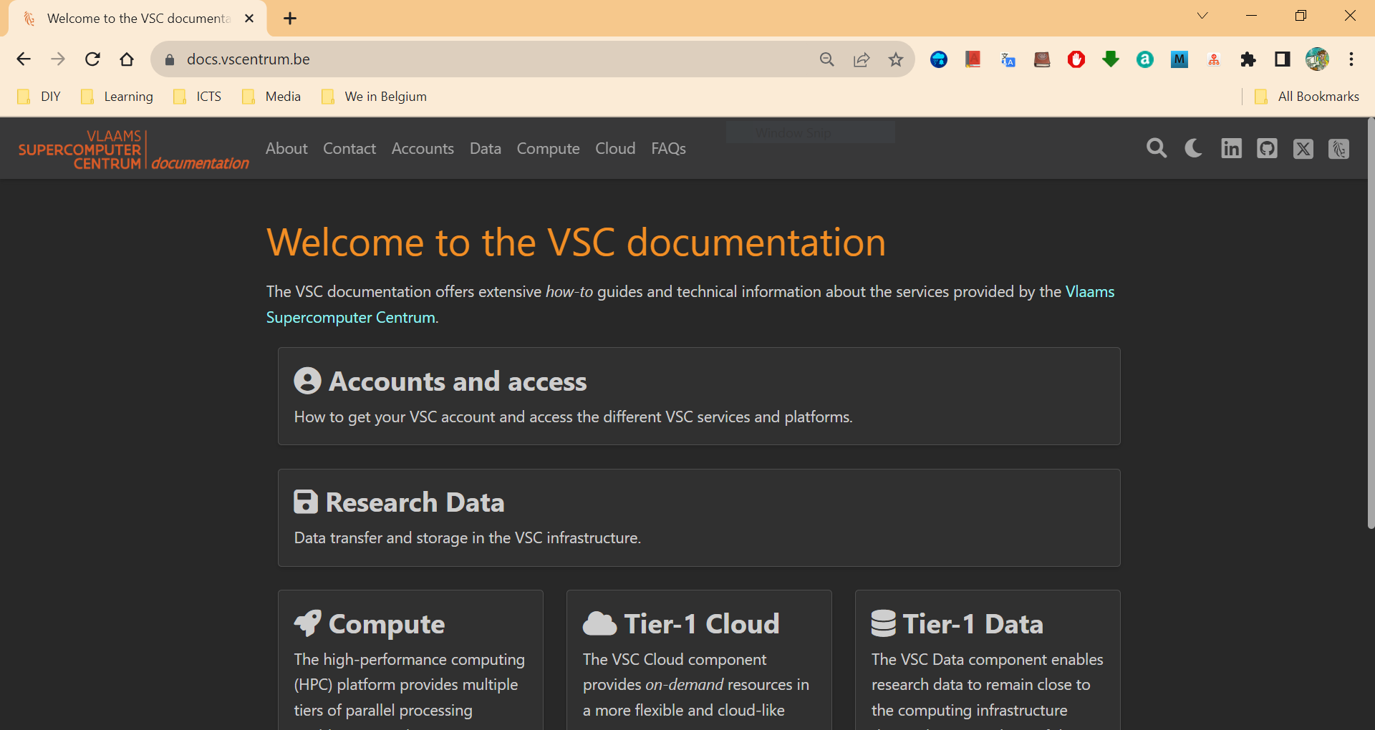
https://docs.vscentrum.be
Search your keywords here; e.g. SSH key
Notes:
All items are indexed
There is a power search engine there.
Just put a keyword there.

Slide 8
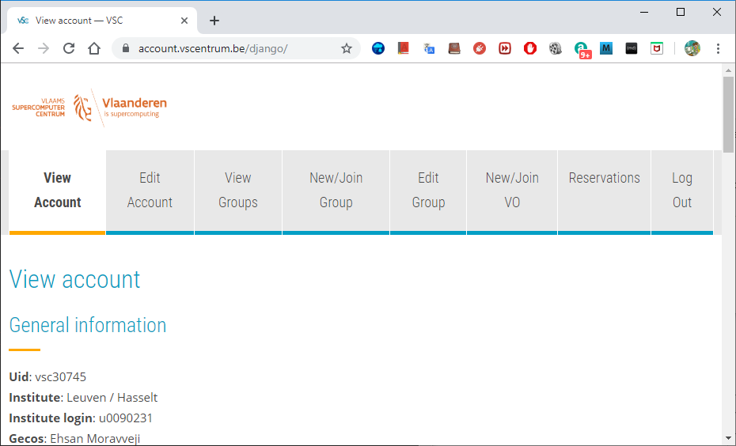
To manage your VSC account: account.vscentrum.be
Upload more SSH public keys
Upload SSH Key Request account
Create or request to join a new group
Moderate your own groups (add/remove users)

Slide 9
Support and Services
Basic support
Helpdesk (hpcinfo@kuleuven.be)
Monitoring and reporting
Application support
Installation and porting
Optimisation and debugging
Benchmarking
Workflows and best practices
Training
Documentation and tutorials
Scheduled trainings / workshops
On request workshops
One-to-one sessions

Slide 10
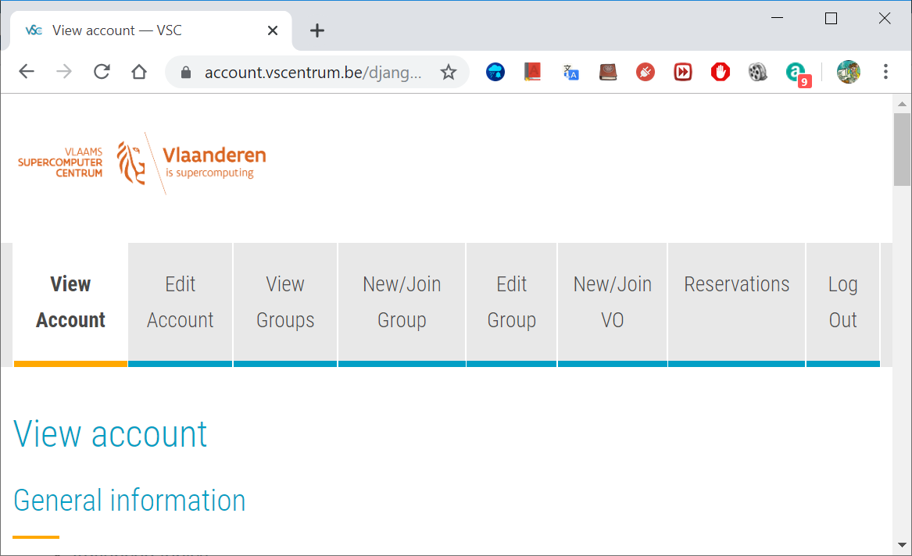
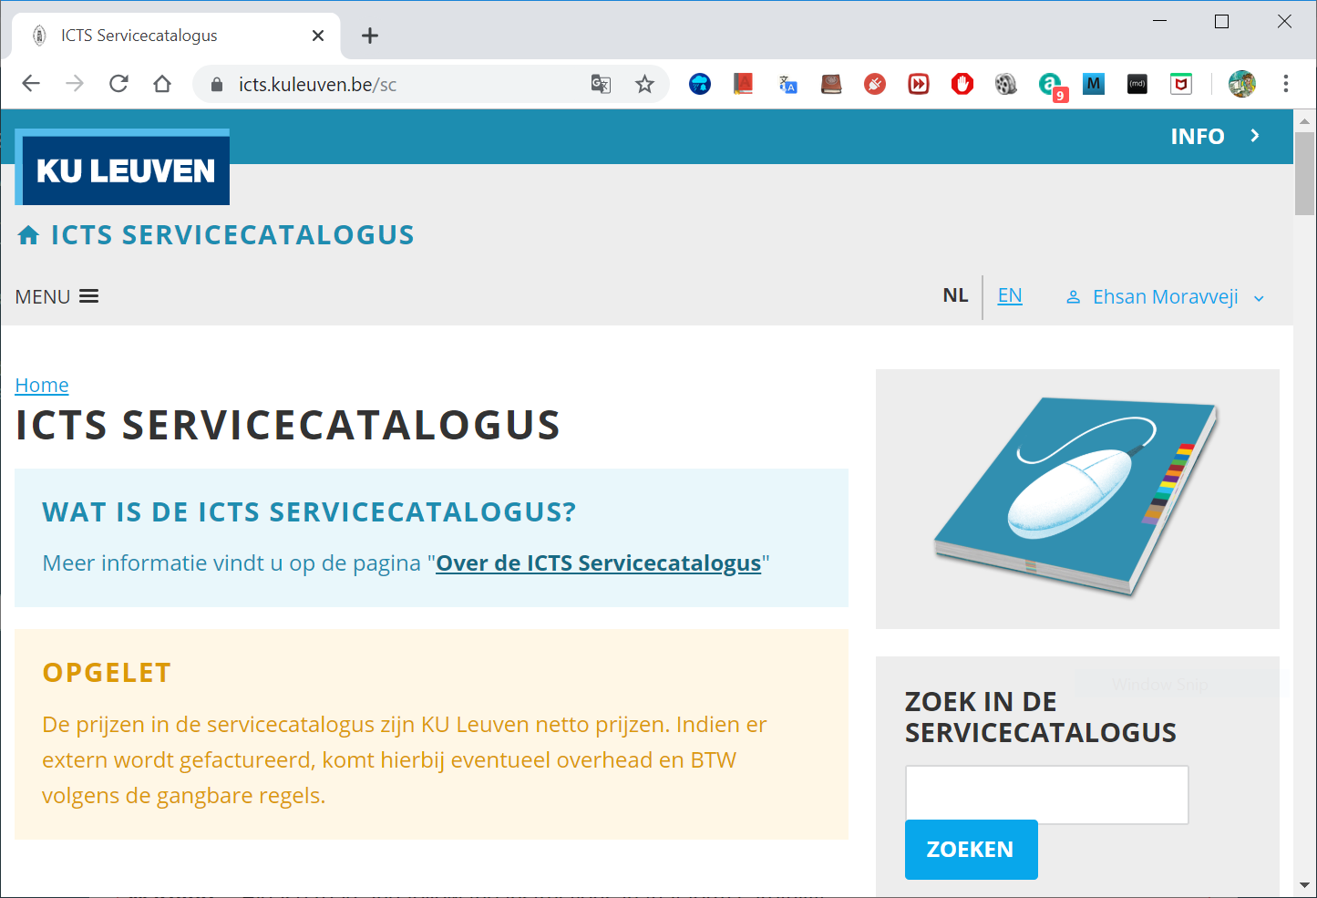
Become a VSC user
(Optional) Create a secure (4096 bit) SSH key pairs Upload it on the account page: www.account.vscentrum.be
You need to request a VSC account Normally processed swiftly
Request introductory credits (2M free credits for 6 months)
Request project credits (for supervisors and project leaders) You need to create a VSC group Add users to the group to give them access to use credits Fill out the request form
Extra storage requests Scratch extension: free of charge
All service costs (compute and storage) are all explained Go to ICTS service catalogus: https://icts.kuleuven.be/sc Click on High Performance Computing (NL/EN)
10

Slide 11
Infosessions:
Containers
Notebooks
VSC training
Matlab (Supercalculator)
Matlab Programming
Linux for HPC
Linux scripting
Introductory
Intermediate
Advanced
Specialized track
Make intro
Linux tools
Linux
HPC intro
CMake intro
Version control systems
C
Python as a second language
Python: System programming
Scientific Python
Python for Software engineering
Python for data science
Python for machine learning
worker/atools
C++ for scientific computing
Julia good bad ugly
Fortran for programmers
High Performance Python
Debugging techniques
OpenMP
?
MPI
Code optimization
Stay up-to-date https://www.vscentrum.be/en/education-and-trainings

Slide 12
To Acknowledge VSC in publications
Why?
At KU Leuven
a contractual obligation for the VSC
helps VSC secure funding
you will benefit from it in the long run
add the relevant papers to the virtual collection "High Performance Computing" in Lirias
In het nederlands
In English
De rekeninfrastructuur en dienstverlening gebruikt in dit werk, werd voorzien door het VSC (Vlaams Supercomputer Centrum), gefinancierd door het FWO en de Vlaamse regering – departement EWI.
The computational resources and services used in this work were provided by the VSC (Flemish Supercomputer Center), funded by the Research Foundation - Flanders (FWO) and the Flemish Government – department EWI.

Slide 13

Tier-2 Clusters

Slide 14
















VSC HPC Environments
Tier-0
Tier-1
Hortense
Tier-2
STEVIN | HYDRA | HOPPER/LEIBNIZ | GENIUS/WICE
14
Notes:
All VSC users can use Tier-2 clusters from any site they desire.
If you still require more compute resources which does not fit into available Tier-2 limits, you can apply for Tier-1 compute time.
Even if Tier-1 level is insufficient, you can apply for Tier-0 level where Belgium is also part of a European consortium.

Slide 15


Tier-2 Clusters @ KU Leuven
Genius (since 2018) 250 nodes: 8,936 cores
wICE (since 9/2022) 186 nodes; 13,392 cores
15

Slide 16
Tier-2 Cluster - Genius
Node type | CPU type | # cores | Total mem | Mem per core (MB) | Partition
Cascadelake | Xeon Gold 6240 | 36 | 192 GB | 5000 | batch
Skylake large mem | Xeon Gold 6240 | 36 | 768 GB | 21000 | bigmem
Skylake GPU | Xeon Gold 6140 4xP100 SXM2 16GB | 36 | 192 GB | 5000 | gpu_p100
Cascadelake GPU | Xeon Gold 6240 8xV100 SXM2 32GB | 36 | 768 GB | 21000 | gpu_v100
Superdome | Xeon Gold 6132 8 sockets | 112 | 6 TB | 53500 | superdome
End of life: end 2024
Access: login.hpc.kuleuven.be
Interconnect: InfiniBand EDR (25 Gb/s)
SSD Disks: 200 GB
Remarks

Slide 17
Tier-2 Cluster - wICE
Node type | CPU type | # cores | Total mem | Mem per core (MB) | Partition
Icelake | Xeon 8360Y | 72 | 256 GB | 3455 | batch_icelake
Sapphire Rapids | Xeon 8468 | 96 | 256 GB | 2500 | batch_sapphirerapids
Icelake large mem | Xeon 8360Y | 72 | 2 TB | 28000 | bigmem
Icelake large mem | Xeon 8360Y | 72 | 8 TB | 111900 | hugemem
Icelake GPU | Xeon 8360Y 4xA100 SXM2 80GB | 72 | 512 GB | 7000 | gpu_a100
AMD GPU | Epyc 9334 4xH100 SXM5 80GB | 64 | 768 GB | 11700 | gpu_h100
Icelake Interactive | Xeon 8358 1xA100 SXM2 80GB | 64 | 512 GB | 7500 | interactive
Phase 1: since September 2022
Access: login.hpc.kuleuven.be
Interconnect: InfiniBand HDR (100 Gb/s)
SSD Disks: 960 GB
Interactive partition: max resources: 8 cores, 1 GPU, 16hr
Remarks

Slide 18

Tier-2 Cluster - wICE
Compute nodes
Large memory nodes
GPU nodes
5x IceLake 72c 2048 GB
4x IceLake 72c 512 GB
4 A100 SXM4 80GB
Interactive nodes
No Dedicated Login Nodes
172x IceLake 72c 256 GB
4x IceLake 64c 512 GB
1 A100 80GB
18

Slide 19
Tier-2 Cluster – wICE extension
Compute nodes
Large memory nodes
GPU nodes
1x IceLake 72c 8 TB
4x AMD Genoa 64c 768 GB
4x H100 SXM5 80GB
68x Sapphire Rapids 96c 256 GB
19

Slide 20
Storage

Slide 21

Overview of the storage infrastructure
Only you own your files (POSIX) Users can share folders via VSC groups
A VSC account has 3 default storages (free of charge)
$VSC_HOME
$VSC_DATA
$VSC_SCRATCH
You can additionally request staging storage
Different storage volumes have different:
mount point
size and performance
use case
backup and maintenance policy
More info on ICTS Service Catalog (EN/NL)

Slide 22
Storage
Example
Do NOT use /tmp It is only 10 GB and is reserved for the OS and root processes. Your application can crash if using /tmp
You are automatically logged into your home folder upon login. Immediately go to your other storages, e.g. $ cd $VSC_DATA
Always check your storage balance using myquota command
$ myquota
file system $VSC_HOME
Blocks: 1479M of 3072M
Files: 12934 of 100k
file system $VSC_DATA
Blocks: 12G of 75G
Files: 1043k of 10000k
file system $VSC_SCRATCH
Blocks: 15M of 1.5T
Request form for extra storage
More information
22

Slide 23
Storage | home folder
Env. Variable | $VSC_HOME
Filesystem Type | NFS
Access | Global
Backup | Hourly, daily, weekly (until last month) inside the .snapshot folder.
Default Quota | 3 GB
Extension | Not possible
Usage | Only storing SSH keys, config files
Remarks | - Stay away from using it - Can easily overflow: + Your jobs may crash + Login issues
Storage
home
data
scratch
node scratch
staging
Tier1 data
23

Slide 24
Storage | data folder
Env. Variable | $VSC_DATA
Filesystem Type | NFS
Access | Global
Backup | Hourly, daily, weekly (until last month) inside the .snapshot folder.
Default Quota | 75 GB
Extension | On purchase
Usage | Your data, code, software, results
Remarks | Permanent storage for initial/final results Not optimal for intensive or parallel I/O
Storage
home
data
scratch
node scratch
staging
Tier1 data
24

Slide 25
Storage | scratch folder
Env. Variable | $VSC_SCRATCH
Filesystem Type | Lustre
Access | Local
Backup | delete after 30 days from last access
Default Quota | 500 GB
Extension | Free
Usage | Intensive, parallel I/O, temporary files
Remarks | Recommended storage for all jobs Copy scratch files to VSC_DATA or local storage after jobs are done Deleted files cannot be recovered
Storage
home
data
scratch
node scratch
staging
Tier1 data
25

Slide 26
Storage | Node scratch folder
Env. Variable | $VSC_SCRATCH_NODE
Filesystem Type | Lustre
Access | On compute node, only at runtime
Backup | None
Default Quota | 591 GB
Extension | Read about beeOND
Usage | Temporary storage at runtime
Remarks | Fastest I/O, attached to the node Is cleaned after job terminates Copy the data to your home, scratch, or staging before job ends
Storage
home
data
scratch
node scratch
staging
Tier1 data
26

Slide 27
Login Nodes & MFA

Slide 28

Accessing a Cluster
Compute nodes
Firewall
Infiniband interconnect
Link to other VSC sites
Scientist
MFA or SSH Authentication
Administration - queue system, job scheduler, user management,…
Login nodes
Service nodes
Storage
28

Slide 29
How to login?
Open OnDemand
SSH client
Web-based login via browser
https://ondemand.hpc.kuleuven.be
Multi-Factor Authentication (MFA): Login first to your institute/university
No SSH-key needed
Windows: PuTTY, MobaXterm, NoMachine MacOS/Linux: terminal, NoMachine
Requires (open)SSH keys
Upload your key to VSC account page wait at least 30 minutes
Hosts: login.hpc.kuleuven.be:22 nx.hpc.kuleuven.be (NX)
Use SSH agent (recommended) Use SSH Config (recommended)
Can open GUIs if X11 is configured
NX
Graphical desktop
Using NoMachine client
Using GUI (Matlab, SAS, visualization)
Nvidia Quatro GPU for visualization
29

Slide 30
Using Login Nodes
To develop code
To check your storage and credit balance
To manage jobs (submit, check status, debug, resubmit, …)
To move data around
within VSC: use data, scratch, staging
outside VSC: copy/sync from/to your local storage (e.g. Globus)
To pre-/post-process your data/jobs
To visualize your data
To share files/folders
Tips
Warning
Do NOT execute heavy-lifting tasks (core, memory)
Login nodes are shared resources
Instead, submit jobs: e.g. Compile your software on compute nodes. Check $ slurmtop to see how busy the cluster is
30

Slide 31
SSH overview
Private keys are always secret
Anyone who can access your private key can log in as you!
Set a passphrase on your private key
Private key is encrypted with this passphrase
Always a pair of keys is needed
Both keys need to be generated together

Slide 32
Generate the key
Linux/Mac OS users:
Use “ssh-keygen ” command to generate key pair
Be sure to give your key a passphrase!
Requested ssh key format: RSA 4096 bit
user@desktop:~> ssh-keygen -t rsa –b 4096 Generating public/private rsa key pair. Enter file in which to save the key (/home/user/.ssh/id_rsa): Enter passphrase (empty for no passphrase): Enter same passphrase again: Your identification has been saved in /home/user/.ssh/id_rsa. Your public key has been saved in /home/user/.ssh/id_rsa.pub. The key fingerprint is: f6:61:a8:27:35:cf:4c:6d:13:22:70:cf:4c:c8:a0:23

Slide 33
Generate the key
Linux/Mac OS users:
Use “ssh-keygen ” command to generate key pair
Be sure to give your key a passphrase!
Default location: ~/.ssh/id_rsa (~/.ssh/id_rsa.pub)
If other location: ssh –i localtion-of–the-file ……
keychain: ssh agent to load the key with passphrase for current linux session

Slide 34
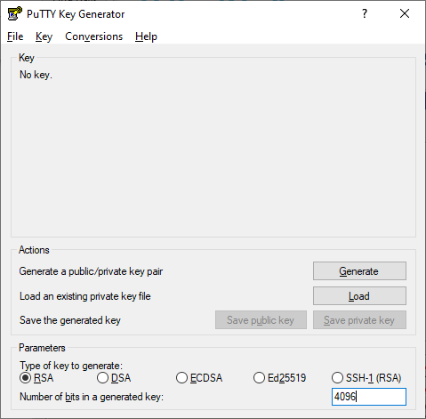
Generate the key
Windows users: use the PuTTYgen key generator.
Request ssh key format: RSA 4096 bit

Slide 35
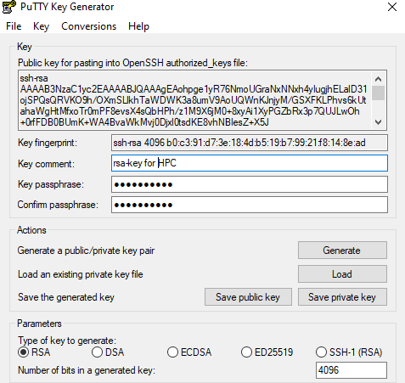
Generate the key
Be sure to give your key a passphrase!

Slide 36
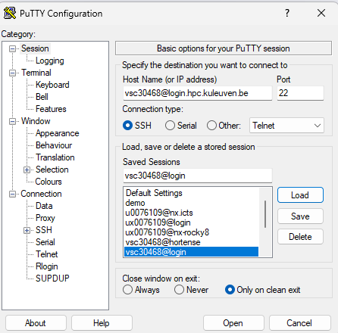
Connecting to the cluster: text mode
Windows users:
PuTTY is a simple-to-use and freely available GUI SSH client for Windows.
Pageant can be used to manage active keys for PuTTY, WinSCP and FileZilla so that you don't need to enter the passphrase all the time.
vsc3XXXX@login.hpc.kuleuven.be

Slide 37
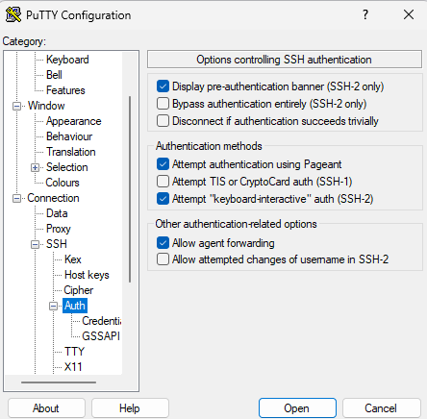
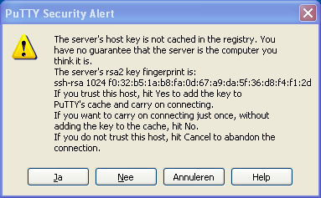
Connecting to the cluster: text mode
Windows users:
PuTTY is a simple-to-use and freely available GUI SSH client for Windows.

Slide 38
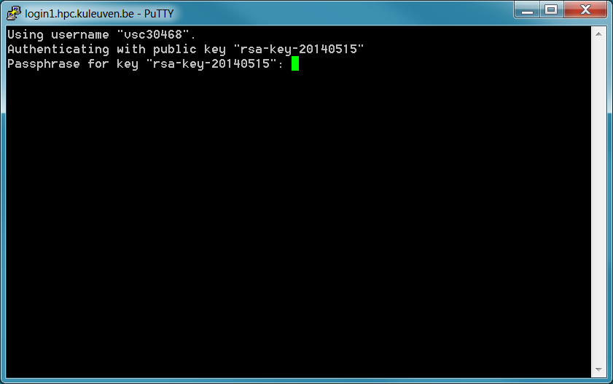
Connecting to the cluster: text mode
Windows users:
If asked for password no for passphrase – please stop connecting and contact suport, otherwise after a few attempts you will be blocked for 24hrs

Slide 39
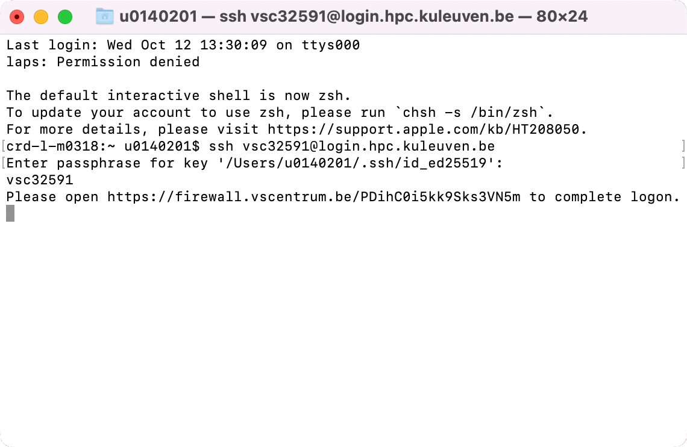
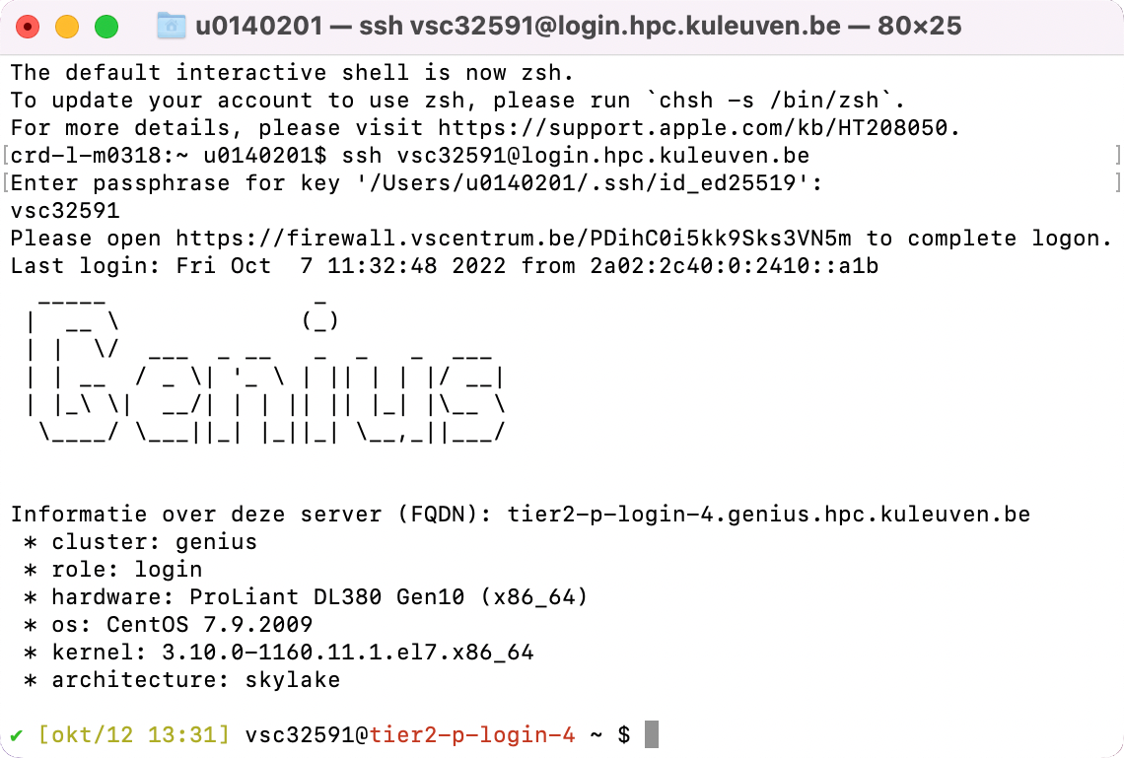
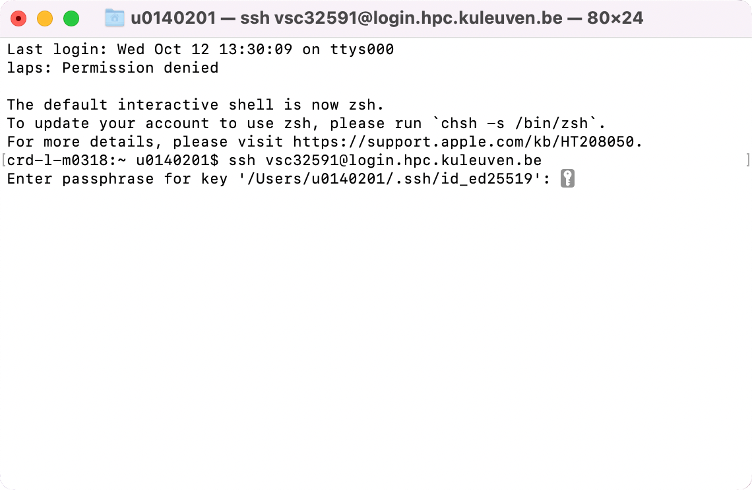
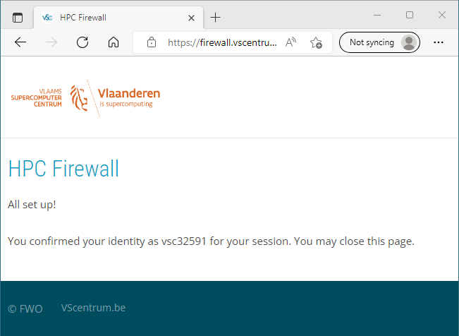
Connecting via Terminal
Host Name: login.hpc.kuleuven.be
(Linux and Mac)
Use ssh to connect: $ ssh vscXXXXX@<host_name>
If key not found: $ ssh -i </path/to/keyfile> ...
If asked for password, please stop connecting and contact support, otherwise after a few attempts you will be blocked for 24h.

Slide 40
Connecting via Terminal
Host Name: login.hpc.kuleuven.be
(Linux and Mac)
With SSH Agent
Check your SSH Agent. Is your SSH key found? $ ssh-add –l
If your SSH Agent is not running: eval $(ssh-agent)
If your key is not found, add it to the Agent: $ ssh-add </path/to/keyfile>
Use ssh to connect (MFA): $ ssh –A vscXXXXX@<hostname>

Slide 41
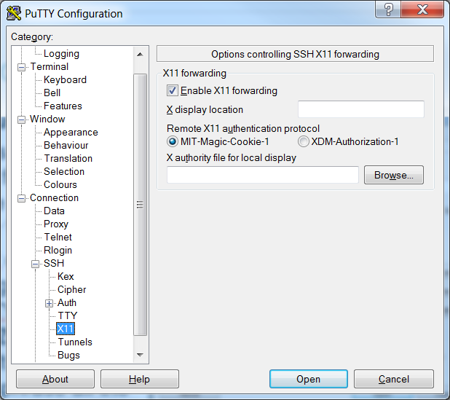
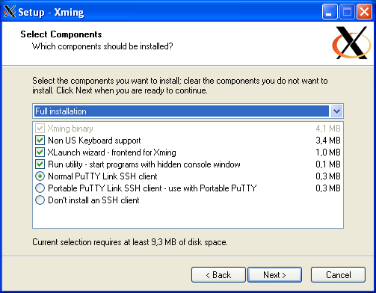
Connecting to the cluster: display graphics
Windows users:
PuTTY is a simple-to-use and freely available GUI SSH client for Windows.
Pageant can be used to manage active keys for PuTTY
Xming: using X-windows to display graphical programs
Linux users:
ssh -X vsc3XXXX@login.hpc.kuleuven.be

Slide 42
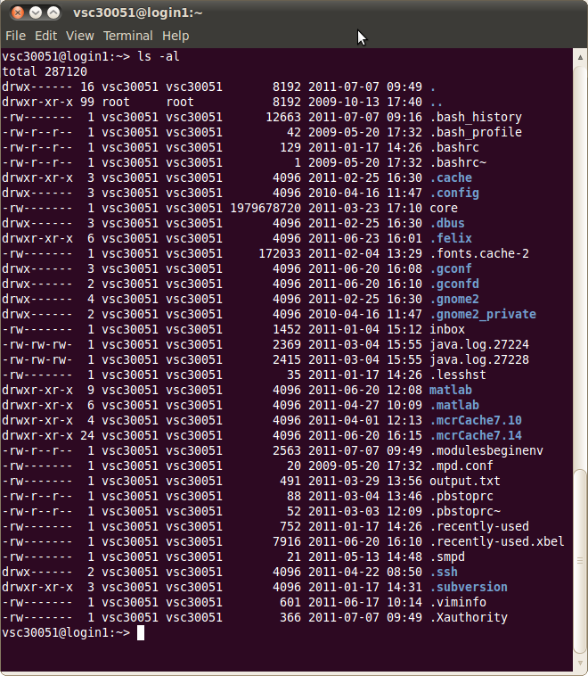
Command Line
Text mode
Provides a way to control the computer via the keyboard.
Is common use on HPC
Is somewhat archaic, but very powerful.
Can be much quicker than a GUI.
Implicitly assumes that you know what your are doing
Don't be scared!
If anything goes wrong, you can stop the command with Ctrl+C

Slide 43
Important rules on the command line
Linux systems are case (and space) sensitive.
MyFile is not same as myfile
There is no "recycle bin" or "trash can" when working in the command line environment. There might be one for GUI. When files are deleted on the command line, they instantly disappear forever.
You should always practice new commands on a test system that is not used in a production environment. This minimizes the chances of an accident that can take down an important system

Slide 44
Important rules on the command line
“\” vs. “/”:
In Linux, the “/” is the directory separator, and the “\” is an escape character.
In Windows, the forward-slash “/” is the command argument delimiter, while the backslash “\” is a directory separator
Filenames:
In Linux, there is no such thing as a file extension. Periods can be placed at any part of the filename, and “extensions” may be interpreted differently by all programs, or not at all.
Windows uses the “.extension” filename convention, (e.g. FILENAME.TXT).

Slide 45
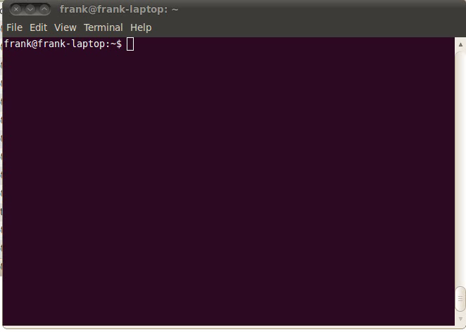
Getting help: command built-in
Help on most Linux commands is typically built into the command themself
These flags usually look like “-h” or “--help”.
$ ls --help

Slide 46
Getting help: man pages
Best source of information can be found in the online manual pages, “man pages” for short. type “man command”.
$ man grep
Tips:
To search for a particular word (e.g. file) within a man page, type “/word”.
To quit from a man page, type the “q” key.
If you do not remember the name of Linux command and you know a keyword relating to the command, search the man pages with the –k $ man -k control

Slide 47
Getting help: info pages
Info pages are similar to man page, but instead of being displayed on one long scrolling screen, they are presented in shorter segments with links to other pieces of information.
Access with the “info” command $ info ls
Tips:
To quit from a info page, type the “q” key.
Type “h” to get more help on the info

Slide 48
Getting help
bash has a built-in help facility available for each of the shell builtins. $ help cd $ help pwd
whatis displays a very brief description of a command $ whatis pwd

Slide 49
Useful commands
Clear the contents of the current screen $ clear
$ logout
The logout command logs your account out of the system (in a text mode).
This will end your terminal session and return to the login screen.
Some systems may have a file called .logout or .bash_logout in each user's home directory.
$ exit
Exit the current shell. The exit command is similar to the logout command with the exception that it does not run the logout script located in the user's home directory.

Slide 50
Linux File System
hierarchical directory structure: files are organized in a tree-like pattern of directories (folders), which may contain files and other directories, etc.
Everything is a file:
Regular files
Directories: files listing a set of files
Symbolic links: files referring to the name of another file
root /: the first directory in the file system.
Note: comparison with Windows,
Windows has a separate file system tree for each storage device (e.g. C-drive, D-drive, I-drive, …)
Linux has a single file system tree, regardless of how many drives or storage devices are attached to the computer. Storage devices are attached (or mounted) at various points on the tree.

Slide 51
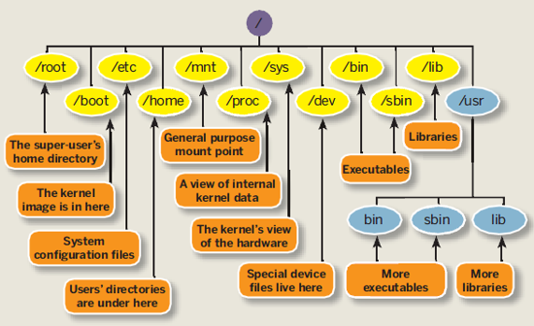
Linux File System
Source: http://linuxsuperuser07.blogspot.be/2011/09/rhel-6-file-system.html

Slide 52
Linux File System
Not imposed by the system. Can vary from one system to the other, even between two GNU/Linux installations!
/ Root directory /bin/ Basic, essential system commands /boot/ Kernel images, initrd, configuration files /dev/ Files representing devices /etc/ System configuration files /home/ User directories /lib/ Basic system shared libraries
/media/ Mount points for removable media

Slide 53
Linux File System
/lost+found/ Corrupt files the system tried to recover /mnt/ Mount points for temporarily mounted filesystems /opt/ Specific tools installed by the sysadmin
/usr/local/ often used instead /proc/ Access to system information /sbin/ Administrator-only commands /sys/ System and device controls
/tmp/ Temporary files
The Unix filesystem structure is defined by the Filesystem Hierarchy Standard (FHS): http://www.pathname.com/fhs/pub/fhs-2.3.html
http://en.wikipedia.org/wiki/Filesystem_Hierarchy_Standard

Slide 54
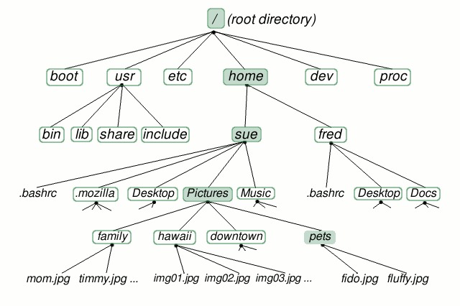
Linux File System-home directory
Source: http://www.linuxplanet.com/linuxplanet/tutorials/6666/1/screenshot3894/

Slide 55
ls command
Lists the files in the current directory, in alphanumeric order, except files starting with the “.” character.
$ ls -a (all) Lists all the files (including .* files)
$ ls -l (long) Long listing (type, date, size, owner, permissions)
$ ls -t (time) Lists the most recent files first
$ ls -S (size) Lists the biggest files first
$ ls -r (reverse) Reverses the sort order
$ ls -ltr (options can be combined) Long listing, most recent files at the end

Slide 56
ls command
$ ls *txt The shell first replaces *txt by all the file and directory names ending by txt (including .txt), except those starting with ., and then executes the ls command line.
$ ls -d .* Lists all the files and directories starting with . -d tells ls not to display the contents of directories. $ ls -d */
$ ls ?.log Lists all the files which names start by 1 character and end by .log
http://www.thegeekstuff.com/2009/07/linux-ls-command-examples/

Slide 57
ls command
vsc30051@login1:~/matlab/test> ls -al
total 1156
drwxr-xr-x 9 vsc30051 vsc30051 8192 2011-03-29 16:10 .
drwxr-xr-x 9 vsc30051 vsc30051 4096 2011-06-20 12:08 ..
drwxr-xr-x 3 vsc30051 vsc30051 4096 2010-01-08 10:54 courseAndreas
-rwxr--r-- 1 vsc30051 vsc30051 149326 2011-03-10 15:14 fibonacci
-rw-r--r-- 1 vsc30051 vsc30051 681 2011-03-10 15:09 fibonacci.m
-rwxr--r-- 1 vsc30051 vsc30051 149068 2011-03-10 12:16 ftest
-rw-r--r-- 1 vsc30051 vsc30051 443 2011-03-10 12:17 ftest_compiled.sh
-rw-r--r-- 1 vsc30051 vsc30051 442 2011-03-10 11:28 ftest_compiled.sh~
-rw-r--r-- 1 vsc30051 vsc30051 70 2011-03-10 12:15 ftest.m
In Linux, file is defined as simply the thing that deals with a sequence of bytes
Hence everything are files: an ordinary file is a file; a directory is also file; a network card, a hard disk, any device are also files since they deal with a sequence of bytes

Slide 58
Moving around
Symbolic (soft) link
Not a real file, just a link to another file
Allows giving another name to a file without actually duplicating it – hence saves memory space
Special file (device)
Each hardware device, e.g. keyboard, hard disk, CD-ROM, etc. is associated with at least one file
Usually store in /dev directory
Applications can read and write any devices by reading and writing their associate file – hence the access method is known as device independent
Divide into two types: character special files, e.g. keyboard, and block special files, e.g. disk

Slide 59
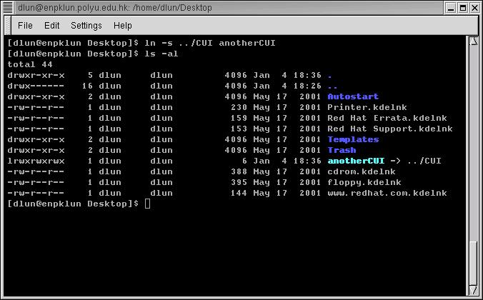
ls command
Command that sets a symbolic link to a file called CUI to anotherCUI
Names in blue are directories, indicated by a letter d at the beginning of the line
A symbolic link begins with a letter l

Slide 60
Moving around
Display the current/working directory
$ pwd
Print Working Directory
displays your current location within the file system.
Change (navigate) directories.
$ cd dir_name
Change Directories
changes the position to the specific directory
You can specify directory names in two ways:
Absolute pathname (starts from the root of the tree)
$ cd /u/home/hpc/test/bin
Relative pathname (relative to your current directory)
$ cd
$ cd .
$ cd ..
$ cd test/bin

Slide 61
Special directories
.
The current directory.
Useful for commands taking a directory argument.
Useful to run commands in the current directory
./readme.txt and readme.txt are equivalent.
..
The parent (enclosing) directory. Always belongs to the . Directory
Typical usage: cd ..
~
Shells just substitute it by the home directory of the current user.
-
cd – jump back to the previous directory

Slide 62
Linux File System - directories
cd .
Source: http://www.linuxplanet.com/linuxplanet/tutorials/6666/1/screenshot3894/

Slide 63
Linux File System - directories
cd ..
Source: http://www.linuxplanet.com/linuxplanet/tutorials/6666/1/screenshot3894/

Slide 64
Linux File System - directories
cd ../..
Source: http://www.linuxplanet.com/linuxplanet/tutorials/6666/1/screenshot3894/

Slide 65
Linux File System - directories
cd /
Source: http://www.linuxplanet.com/linuxplanet/tutorials/6666/1/screenshot3894/

Slide 66
Linux File System - directories
cd -
Source: http://www.linuxplanet.com/linuxplanet/tutorials/6666/1/screenshot3894/

Slide 67
Linux File System - directories
cd ~
Source: http://www.linuxplanet.com/linuxplanet/tutorials/6666/1/screenshot3894/

Slide 68
Linux File System-home directory
Relative path
cd ../Desktop
Source: http://www.linuxplanet.com/linuxplanet/tutorials/6666/1/screenshot3894/

Slide 69
Linux File System - directories
Relative path
cd ~/Desktop
Source: http://www.linuxplanet.com/linuxplanet/tutorials/6666/1/screenshot3894/

Slide 70
Linux File System - directories
Full path
cd /home/sue/Desktop
Source: http://www.linuxplanet.com/linuxplanet/tutorials/6666/1/screenshot3894/

Slide 71
File paths
A path is a sequence of nested directories with a file or directory at the end, separated by the / character
Relative path: documents/fun/file1 Relative to the current directory
To work with relative paths they need to have connection on the linux tree
Absolute path: /home/user/leuven/file2
/ : root directory. Start of absolute paths for all files on the system
Not a superuser’s home directory (-> /root)

Slide 72
More on files
What does a file contain?
Determine a file's type: file
will print a brief description of the file's contents
$ file filename
Search for files and directories
The find command performs a raw search on a file system to locate the specified items.
$ find location –name some-name
($ find /home/student -name *desktop)
Be careful: results can sometimes be slow
Search the locate database for files and directories
The locate command displays the location of files that match the specified name.
Faster than find because it searches a database of indexed filenames.
Disadvantage: lacks the ability to search for advanced characteristics such as file owner, size, and modification time.

Slide 73
File names
File name features:
Case sensitive
No obvious length limit (255 characters)
Can contain any character (including whitespace, except /).
File name extensions not needed and not interpreted. Just used for user convenience. (File types stored in the file)
a hidden file is any file that begins with a “.” (not seen with the bare ls
File name examples: README .bashrc index.htm index.html index.html.old

Slide 74
Auto-Completion
Have the shell automatically complete commands or file paths.
Activated using the <TAB> key on most systems
examples
$ whe<TAB>
$ whereis
$ ls -l /etc/en<TAB>
$ ls -l /etc/environment
When more than one match is found, the shell will display all matching results (use <TAB> twice)
$ ls -l /etc/host<TAB>

Slide 75
Command history: Arrow Up
Previously executed commands can be recalled by using the Up Arrow key on the keyboard.
Most Linux distributions remember the last five hundred commands by default.
Display commands that have recently been executed
The history command displays a user's command line history.
You can execute a previous command using ![NUM] where NUM is the line number in history you want to recall.

Slide 76
Globbing: use wildcard
Wildcard | Function
* | Matches 0 or more characters
? | Matches 1 character
[abc] | Matches one of the characters listed
[a-c] | Matches one character in the range
[!abc] | Matches any character not listed
[!a-c] | Matches any character not listed in the range
{tacos,nachos} | Matches one word in the list
$ ls -l /etc/host*
$ ls -l /etc/hosts.{allow,deny}
$ ls -l /etc/hosts.[!a]*
$ ls -l /etc/host?

Slide 77
Input and Output
Programs and commands can contain an input and output. These are called ‘streams’. UNIX programming is oftentimes stream based.
STDIN – ‘standard input,’ or input from the keyboard
SDTOUT – ‘standard output,’ or output to the screen
STDERR – ‘standard error,’ error output which is sent to the screen.

Slide 78
File Redirection
Often we want to save output (stdout) from a program to a file. This can be done with the ‘redirection’ operator.
myprogram > myfile – using the ‘>’ operator we redirect the output from myprogram to file myfile
Similarly, we can append the output to a file instead of rewriting it with a double ‘>>’
myprogram >> myfile – using the ‘>’ operator we append the output from myprogram to file myfile

Slide 79
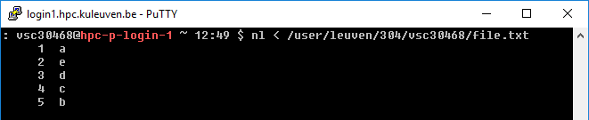
Input Redirection
Input can also be given to a command from a file instead of typing it to the screen, which would be impractical.
mycommand < programinput – using the ‘< ’ operator we redirect the input from the file programinput to mycommand
programinput is printed to stdout, which is redirected to a command mycommand.
Not all commands read standard input (ls, date, who, pwd, cd, ps, …)

Slide 80
Redirecting stderr
Performing a normal redirection will not redirect sdterr. In Bash, this can be accomplished with ‘2>’
command 2> file1
Or, one can merge stderr to stdout (most popular) with ‘2>&1’
command > file 2>&1

Slide 81
Pipes
Using a pipe operator ‘|’ commands can be linked together. The pipe will link the standard output from one command to the standard input of another.
Very helpful for searching files
e.g. when we want to list the files, but only the ones that contain test in their name:
ls -la|grep test

Slide 82
Pipes
INPUT
0
Lots of Little Tools
echo “Hello” | \
wc -c
echo
OUTPUT
ERROR
1
2
A Pipe!
INPUT
0
wc
OUTPUT
ERROR
1
2

Slide 83
Difference Between Single, Double, and Backwards Quote
Single quotes (‘) do not interpret any variables
Double quotes (“) interpret variables
Backwards quotes (`) interpret variables and treat them as a program to run and return the results of that program

Slide 84
Quote characters
There are three different quote characters with different behaviour. These are:
“ : double quote, weak quote. If a string is enclosed in “ ” the references to variables (i.e $variable ) are replaced by their values. Also, back-quote and escape \ characters are treated specially.
‘ : single quote, strong quote. Everything inside single quotes are taken literally; nothing is treated as special.
` : back quote. A string enclosed as such is treated as a command and the shell attempts to execute it. If the execution is successful, the primary output from the command replaces the string.
Example: echo “Today is:” `date`

Slide 85
File Manipulation
For all file manipulation commands relative of absolute paths can be used (or just files in the current directory when no extra path specified)
Most of the commands are intuitive – shortcuts of English names

Slide 86
Directories
Create directories
The mkdir command is used to create directories
$ mkdir dir1 dir2 dir3
Remove directories
The rmdir command removes directories
$ rmdir dir1
rmdir will only remove empty directories. To remove a non-empty directory, use
$ rm -r [DIRECTORY] instead.

Slide 87
Copy a file
The cp command copies files and directories
The default behavior will overwrite any existing file(s). The -i option overrides this behavior and prompts the user before overwriting the destination file.
syntax: cp [OPTIONS] [SOURCE] [DESTINATION]
$ cp <source_file> <target_file> Copies the source file to the target.
$ cp file1 file2 file3 ... dir Copies the files to the target directory (last argument).
$ cp -i (interactive) Asks for user confirmation if the target file already exists
$ cp -r <source_dir> <target_dir> (recursive) Copies the whole directory.
$ cp –v (verbose)
Displays what has been copied

Slide 88

Move or rename files
Move or rename files and directories: mv
The default behavior will overwrite any existing file(s).
syntax: mv [OPTIONS] [SOURCE] [DESTINATION]
$ mv old_name new_name Renames the given file or directory.
$ mv -i (interactive) If the new file already exits, asks for user confirm
The mv command can also be used to move or rename directories
$ mv NewFiles/ OldFiles/
-r option is not necessary

Slide 89
Remove files
The rm command removes files.
$ rm file1 file2 file3 ... Removes the given files.
$ rm -i (interactive) Always ask for user confirmation.
$ rm -r dir1 dir2 dir3 (recursive) Removes the given directories with all their contents.
Tip: Whenever you use wildcards with rm (besides carefully checking your typing!), test the wildcard first with ls. This will let you see the files that will be deleted. Then press the up arrow key to recall the command and replace the ls with rm.

Slide 90
Create links
Create links (shortcuts) to files or directories: ln
Symbolic links are created when using the -s option with the ln command.
Allows to jump to other files or locations on the file system
Editing a symbolic link file is the same as editing the source file, but deleting the symbolic link does not delete the source file.
$ ln -s file_v5.doc file_final.doc
creates a symbolic link called file_final.doc that points to file_v5.doc
$ ln -s /home/demo/dir1/dir2/dir3 /home/demo/jump2dir
creates a symbolic link called jump2dir that points to a deep directory - allows for quicker access)

Slide 91
Text editors
Text-only text editors
Often needed for sysadmins and great for power users
vi, vim
nano
Graphical text editors
Fine for most needs
Gedit,
Kate, Nedit
Emacs, Xemacs
http://www.thegeekstuff.com/2009/07/top-5-best-linux-text-editors/

Slide 92
Text editors
How to start:
Create a file
$ touch filename (creates an empty file)
start editing (non)-existing file:
$ vi filename
$ nano filename
$ gedit filename

Slide 93
vi
Text-mode text editor available in all Linux systems.
Created before computers with mice appeared.
Difficult to learn for beginners used to graphical text editors.
Very productive for power users.
Check the web for tutorials:
https://upload.wikimedia.org/wikipedia/commons/d/d2/Learning_the_vi_Editor.pdf
ftp://ftp.vim.org/pub/vim/doc/book/vimbook-OPL.pdf

Slide 94
vi
2 basic modes of operation:
command mode and editing mode.
Within Command Mode, signals from the terminal are interpreted as editing commands.
Editing mode: letters typed at the keyboard are inserted into the editing buffer.
Pressing Esc on the keyboard activates command mode.
Key(s) | Function | Key(s) | Function
:w | Save | A | Append text after
:x | Save and exit | r | Replace text before cursor
:q | Quit | R | Replace text after cursor
I | Insert text after | i | Insert text before
P | Paste copied text | yy | Copy current line
a | Append text before | /[TEXT] | Search for the specified text

Slide 95
Vi
2 modes
Input mode
ESC to back to cmd mode
Command mode
Cursor movement
h (left), j (down), k (up), l (right)
^f (page down)
^b (page up)
^ (first char.)
$ (last char.)
G (bottom page)
:1 (goto first line)
Switch to input mode
a (append)
i (insert)
o (insert line after
O (insert line before)
Delete
dd (delete a line)
d10d (delete 10 lines)
d$ (delete till end of line)
dG (delete till end of file)
x (current char.)
Paste
p (paste after)
P (paste before)
Undo
u
Search
/
Save/Quit
:w (write)
:q (quit)
:wq (write and quit)
:q! (give up changes)

Slide 96
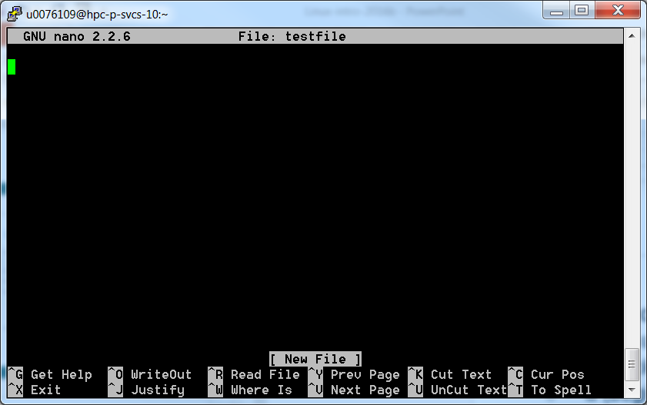
Nano
Exit=Ctrl+X

Slide 97
Displaying file contents
Several ways of displaying the contents of files.
$ cat file1 displays the contents of the given file.
$ cat file1 file2 file3 ... (concatenate) Concatenates and outputs the contents of the given files.
$ more file1 Display the output of a command or text file one page at a time.
Can also jump to the first occurrence of a keyword (/ command).

Slide 98
Displaying file contents
$ less file1 Does more than more. Doesn't read the whole file before starting. Supports backward movement in the file (? command).
Press q to exit
$ display file1
Displays graphical file (simple image)

Slide 99
The head and tail commands
$ head [-<n>] <file> Displays the first <n> lines (or 10 by default) of the given file. Doesn't have to open the whole file to do this!
$ tail [-<n>] <file> Displays the last <n> lines (or 10 by default) of the given file. No need to load the whole file in RAM! Very useful for huge files.
$ tail -f <file> (follow) Displays the last 10 lines of the given file and continues to display new lines when they are appended to the file. Very useful to follow the changes in a log file, for example.

Slide 100
The grep command
$ grep <pattern> <files> Scans the given files and displays the lines which match the given pattern.
$ grep error *.log Displays all the lines containing error in the *.log files
$ grep -i error *.log Same, but case insensitive
$ grep -ri error . Same, but recursively in all the files in the current directory and its subdirectories
$ grep -v info *.log Outputs all the lines in the files except those containing info.
http://www.thegeekstuff.com/2009/03/15-practical-unix-grep-command-examples/

Slide 101
wget
Instead of downloading files from your browser, just copy and paste their URL and download them with wget
main features
http and ftp support
Can resume interrupted downloads
Can download entire sites or at least check for bad links
Very useful in scripts or when no graphics are available (system administration, embedded systems)
$ wget -c http://microsoft.com/customers/dogs/winxp4dogs.zip Continues an interrupted download.
$ wget -r -np http://www.xml.com/ldd/chapter/book/ Recursively downloads an on-line book for off-line access. -np: "no-parent". Only follows links in the current directory.

Slide 102
Measuring disk usage
$ du -h <file> -h: returns size on disk of the given file, in human readable format: K (kilobytes), M (megabytes) or G (gigabytes), Without -h, du returns the raw number of disk blocks used by the file (hard to read). Note that the -h option only exists in GNU du.
$ du -sh <dir> -s: returns the sum of disk usage of all the files in the given directory.

Slide 103
File Archiving: tar
Saves and restores multiple files to/from a single file. Directories followed recursively.
Format:
$ tar [options] [options_values] [files]
c – create a new archive
v – verbosely list files which are processed.
f – following is the archive file name
z – filter the archive through gzip (compress)
x – extract files from archive
j - filter the archive through bzip (compress)

Slide 104
File Archiving: tar
Examples:
$ tar -cvf [FILE] [ITEM] Backup the specified item(s)
$ tar -cvf /tmp/backup.tar ~/data ~/test
$ tar -czvf [FILE] [ITEM] Compress the archive to save space
$ tar -xvf [FILE] [ITEM] Restore the specified item(s) $tar -xvf backup.tar
$ tar -tf [FILE] List all files in the specified archive
e.g. $ tar -tf backup.tar
http://www.thegeekstuff.com/2010/04/unix-tar-command-examples/

Slide 105
File Compression: gzip
Compressing files: gzip filename or bzip2 filename
$ gzip backup.tar
$ bzip2 backup.tar
The resulted file is backup.tar.gz/ backup.tar.bz2
Uncompressing files: gzip -d filename.gz or bzip2 –d filename.bz2
$ gzip –d backup.tar.gz
$ bzip2 –d backup.tar.bz2
The uncompressed file is backup.tar

Slide 106
File access rights
Linux File Access Privilege
Linux is a multiuser system, the files of all users are stored in a single file structure
Mechanism is required to restrict one user to access the files of another user, if he is not supposed to
User can impose access permission to each file to restrict its access
The term “access permission” refers to
read permission
write permission
execute permission

Slide 107
File access rights
3 types of access rights
Read access (r)
reading, opening, viewing, and copying the file is allowed
Write access (w)
writing, changing, deleting, and saving the file is allowed
Execute rights (x)
executing and invoking the file is allowed. This is required for directories to allow searching and access.
Use ls -l to check file access rights

Slide 108
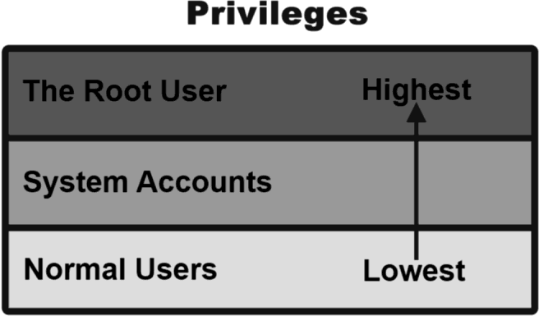
File access rights
3 types of access levels
User (u): for the owner of the file
Group (g): each file also has a “group” attribute, corresponding to a given list of users
Others (o): for all other users

Slide 109
File access rights
File last modified date
Hard link no
Owner’s group
Owner
d rwx r-x r-x 2 dlun dlun 4096 May 17 2001 Autostart
It is a directory
file size
file name
The directory can be read, written and executed by the user dlun
The directory can be read and executed but not written by other users in the same group of dlun
The directory can be read and executed but not written by other users in different group of dlun
The group of a user is assigned by the administrator when a user is added to the system

Slide 110
File access rights
Access permission can also be assigned to a directory
Directory is also a file that contains the attributes of the files inside it
If read permission is not given to a directory
cannot show the structure of this directory
e.g. cannot use ls
If write permission is not given to a directory
cannot modify anything of the directory structure
e.g. cannot copy a file into this directory since it will modify the directory structure by adding one more file
If execute permission is not given to a directory
nearly nothing can be done with this directory, even cd

Slide 111
Access rights examples
-rw-r--r-- Readable and writable for file owner, only readable for others
-rw-r----- Readable and writable for file owner, only readable for users belonging to the file group.
drwx------ Directory only accessible by its owner
-------r-x File executable by others but neither by your friends nor by yourself. Nice protections for a trap...

Slide 112
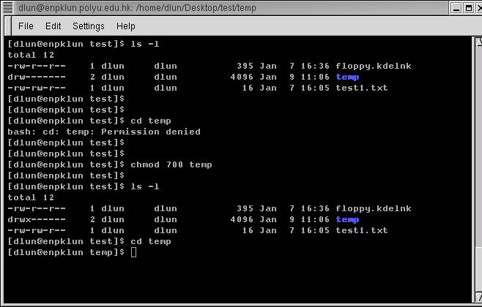
Access rights examples
temp does not have execution right
even cd is not workable
execution right is added
now we can change the directory to temp

Slide 113
chmod: changing permissions
Permissions allow you to share files or directories or to lock them down to be private.
$ chmod (change mode)
$ chmod <permissions> <files> 2 formats for permissions:
octal format (3 digit octal form)
symbolic format

Slide 114
chmod: changing permissions
octal format (abc): a,b,c = r*4+w*2+x*1 (r, w, x: booleans)
0 none ---
1 execute-only --x
2 write -w-
3 execute and write -wx
4 read-only r–
5 read and execute r-x
6 read and write rw-
7 read, write, and execute rwx
$ chmod 644 <file> (rw for u, r for g and o)
660 : 110 110 000
⇒ rw- rw- ---
545 : 101 100 101
⇒ r-x r-- r-x

Slide 115
chmod: changing permissions
symbolic format: $ chmod go+r: add read permissions to group and others. $ chmod u-w: remove write permissions from user. $ chmod a-x: (a: all) remove execute permission from all.

Slide 116
Access right constraints
x is sufficient to execute binaries Both x and r and required for shell scripts.
Both r and x permissions needed in practice for directories: r to list the contents, x to access the contents.
You can't rename, remove, copy files in a directory if you don't have w access to this directory.
If you have w access to a directory, you can remove a file even if you don't have write access to this file (remember that a directory is just a file describing a list of files). This even lets you modify (remove + recreate) a file even without w access to it.

Slide 117
Process
“Everything in Unix is a file. Everything in Unix that is not a file is a process”
Processes
Instances of a running programs
Several instances of the same program can run at the same time
Processes are assigned a unique identifier which is used to monitor and control the process (PID)

Slide 118
Process
A program that is claimed to be executing is called a process
For a multitasking system, a process has at least the following three states:
Start execution
Ready
Running
Finish execution
Sleeping

Slide 119
Process
Ready state
All processes that are ready to execute but without the CPU are at the ready state
If there is only 1 CPU in the system, all processes except one are at the ready state
Running state
The process that actually possesses the CPU is at the running state
If there is only 1 CPU in the system, at most there is only one process is at the running state
Sleeping state
The process that is waiting for other resources, e.g. I/O, is at the sleeping state

Slide 120
ps
Display running processes (cfr. Windows Task Manager ctrl-shift-esc)
$ ps Display the current user's processes
$ ps -e Display all processes running on the system
$ ps -ef Display detailed information about running processes
$ ps -u [USER] Display processes owned by the specified user
$ ps a Display extra info (running state)

Slide 121
Process
PID TTY STAT TIME COMMAND
14748 pts/1 S 0:00 –bash
pts/0 S 0:00 –bash
14974 pts/0 S 0:00 vi test1.txt
14876 pts/1 R 0:00 ps …
How much time the process is continuously executing
State:
S – Sleeping
(waiting for input)
R – Running
Process ID
Terminal name
For the example above, both bash processes, which are the shell of both terminals, are waiting for the input of user. They must be in the sleeping state
The vi process, which is an editor, is also waiting for the input of user. Hence it is also in sleeping state
When ps reporting the processes in the system, it is the only process that is running. Hence it is in running state

Slide 122
kill
Sends an abort signal to the given processes. Lets processes save data and exit by themselves. Should be used first.
$ kill <pid> Example: $ kill 3039 3134 3190 3416
$ kill -9 <pid> Sends an immediate termination signal. The system itself terminates the processes. Useful when a process is really stuck.

Slide 123
&
& is a command line operator that instructs the shell to start the specified program in the background.
This allows you to have more than one program running at the same time without having to start multiple terminal sessions.
Starting a process in background: add & at the end of your line: $ gedit & check with ps

Slide 124
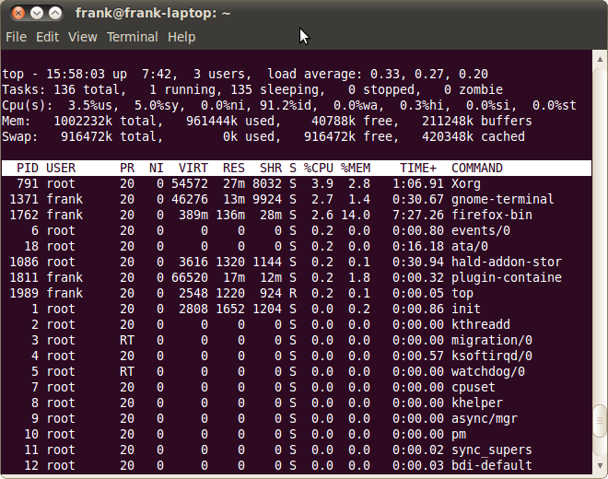
top
Displays most important processes, sorted by cpu percentage (use > or < to change the order)
http://www.thegeekstuff.com/2010/01/15-practical-unix-linux-top-command-examples/

Slide 125
List of basic commands
Managing files and directories:
cp, mv, rm, mkdir, rmdir, touch
Displaying content of files
cat, more, less, head, tail
Moving around
pwd, cd, ls
Asking for help
help, man, info, whatis
+ understanding of Linux directory tree (relative and absolute paths)
+ understanding of file permissions

Slide 126
Tier-2 credit system - what
What is a credit
Credits are a measure for compute time
Shared nodes are charged based on used fraction
Cluster / Partition | Credits/h
Genius Skylake / Cascadelake / AMD | 10 000
Genius Skylake BigMem | 12 000
Genius Skylake 4 GPUs | 20 000
Genius Cascadelake 8 GPUs | 39 900
Genius Superdome | 126 000
wICE Icelake thin node | 11 000
wICE Icelake Large Memory | 19 000
wICE IceLake GPU node | 45 000
wICE interactive node | /
Check ICTS service catalogue : https://icts.kuleuven.be/sc/english/research/HPC
Notes:
What is a credit? A credit is nothing more than a measure for an amount of compute time. How we came to the current credit ratio is a long history, which is not really relevant.
The list below shows the current types of nodes in our Tier-2 environment and there credit usage ratio. Please consult the service catalogue for up to date available systems, their credit rates and the credit cost.
From the table you can see that a GPU node is a lot more expensive. But these also includes the four or eight GPUs in the machine. Which are actually very expensive, so it's reasonable that these nodes consume a lot more credits. As Superdome has 6TB of RAM with 144 cores, you can understand that this is our most expensive node at the moment.
Slurm allows us to configure the different type of resources that should be accounted. We have focused it on usage of CPU cores and GPU devices. each resource will use a number of credits for a given time. The table shows the credits usage of a full node (all available cores/GPU’s) when using it for one hour.
Why are the ratios so high, yu might ask? When we started using Slurm, the credits/hour ratio was multiplied with a factor 1000 to assure that Slurm internals is billing the credits with enough accuracy. But no worries you are also getting 1000 times more credits for your money.
Note that nodes can be used in a shared mode, When submitting a job with only one GPU and a quarter of the cores, it will be only charged for using one single GPU. The same goes for the CPU nodes, you will be only charged for the CPUs that are used. But mind that in case you are using more than defualt RAM memory per core, also the additional cores will be charged. In the extrem case if you would use a single core and the whole node memory, you will be charged for the full node.

Slide 127
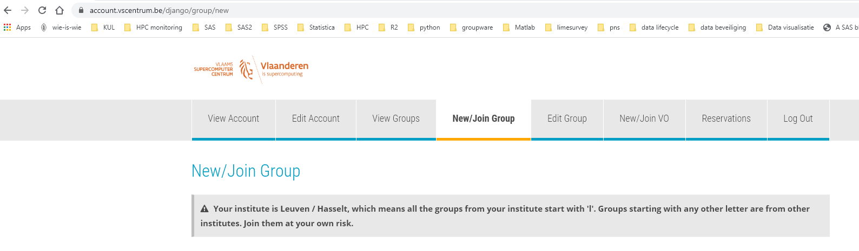
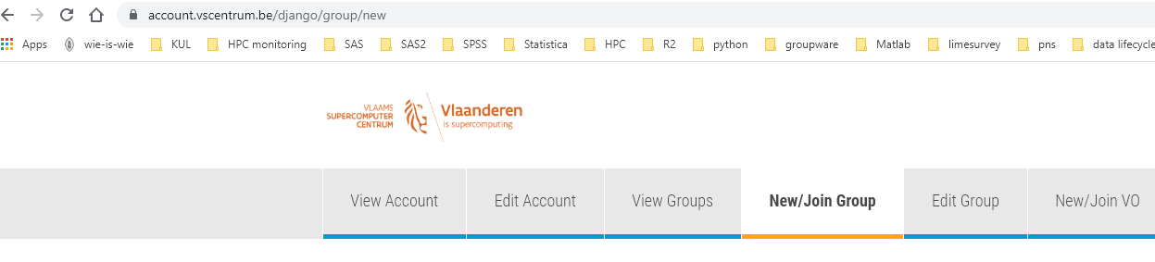
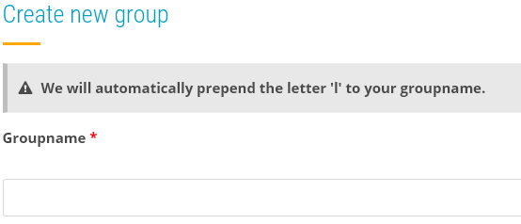
Tier-2 credit system – how to get credits
Check ICTS service catalogue : https://icts.kuleuven.be/sc/english/research/HPC
Request your introduction credits
Everybody
Free of charge
1 time
6 months
Request permission to join a group
Request project credits
Create group on the accountpage
Start the name preferably with p_
Your group will be lp_
Who creates the group can add or remove users
Tier-2 credits are shared over all Tier-2 system
Notes:
How do you get your hands on some compute credits?
Well first of all each user can request introduction credits. It is a one time thing, you get 2 million credits free of charge.
As the name indicates, it is meant to to give you some time to get acquainted with the Tier-2 cluster.
Check the service catalog for the procedure to follow to request these introduction credits.
If you will be joining a research group that already is computing on the cluster then probably they already have a project with compute credits.
In that case just ask your fellow researchers the name of this project.
Then go to the account page, do a join request,
select the join group option,
type in the name of the of the project and
then send a request to be added to the group.
The moderator will see this group and can accept or reject. Once accepted you will be able to use the credits that are linked to this project group.
If you're starting, you have your own research group and you want to request project credits for yourself it's also possible.
The procedure is in the service catalog but know that you best
first create a new group,
give it a name that makes sense to for you and start the name with P underscore. This will make it clear that is is a project meant for project credits.
the system will automatically prefix your name with an L because it's a group created in Leuven.
Groups created by users in Ghent will have a G as a prefix and groups from Antwerp will have an A as a prefix.
When you create a group you will be moderator of the group and you can decide who to invite, accept or remove from your group.
You're in complete control of who has access to the compute credits that are bound to this group.
By default the credits are available on all Tier-2 systems.

Slide 128
Tier-2 credit system - how
Submit your jobs with reference to the correct project
#SBATCH –A lp_myproject
sbatch … -A lp_myproject
Before submitting the job, the amount of available credits is checked with the maximum requested credits for the job
Maximum charge for the submitted jobs is calculated
Credits = minutes * floor(#cpu cores*billing_weight_CPU + #gres*billing_weight_gres)
Taking into account any running jobs
When the job finishes, the actual cost is charged
Notes:
So once you have access to the compute credits how do you use them?
Well this has already been shown in the videos before.
You need to specify your project on the SBATCH directive with a minus A option and then the name of your project.
You can do this both in a Slurm script as on the SBATCH command line.
How does charging actually works?
First of all when you submit your job the maximum amount of credits that your job can cost will be computed. This is based on the number of CPU cores that you request, the number of requested GPUs , The type of the cpu and the requested wall time.
This gives the maximum amount of credits that will be used for this job.
Before the jobs get submittted, the system will check if there are enough credits available. This will take into account the current balance and the number of credits that are needed for any job that is currently running.
When the job is finished only the actual cost will be charged. So if you request three days wall time but your job is finished after one day you only will be charged for this one day of computation.
With the sam-quote tool you can get a calculation of the credit cost, based on the specified parameters.

Slide 129
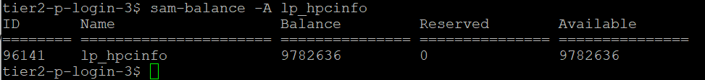
Tier-2 credit system – manage your credits
Slurm Accounting Manager => sam- commands
Command | Purpose
sam-balance [-A account] | List active projects and available credits
Notes:
There are a number of commands that you can use to manage your credits.
One thing all the commands have in common that is that they start with sam-
It is the abbreviation for "Slurm Accounting Manager" . These scripts wrapp standard slurm commands, but give you an easy to read output.
The first one is sam-balance. It will give you an overview of all your active projects and their status. With the optional minus A you can query a specific account .
In the overview The reserved column are credits of jobs that are still running and not yet have substracted from the account. The available column shows the effective amount of credits available to submit new jobs.

Slide 130
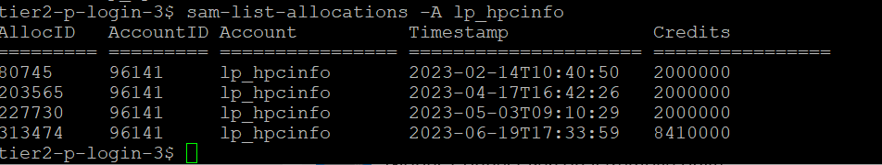
Tier-2 credit system – manage your credits
Slurm Accounting Manager => sam- commands
Command | Purpose
sam-list-allocations –A <account-name> | List the validity dates of different projects/allocations
Notes:
Another command which is very useful is the sam-list allocations, followed with minus A and the account name. The different deposits in this project will be shown, in this account and they all had a different deposit date.

Slide 131
Tier-2 credit system – manage your credits
Slurm Accounting Manager => sam- commands
Command | Purpose
sam-quote sbatch [sbatch arguments] [my_job.slurm] | Shows the amout of credits a job will use
Notes:
Sam-quota will give you an estimated of the amount of credits you need to run the job. You can run it by supplying a batch script or by adding specific SBATCH directives on the command line.

Slide 132
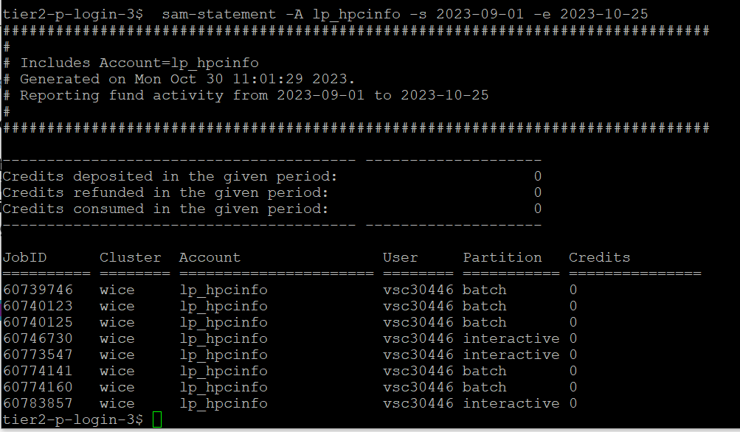
Tier-2 credit system – manage your credits
Slurm Accounting Manager => sam- commands
Command | Purpose
sam-statement -A <account-name> -s <start-date> -e <end-date> | Overview of credits used on each job in a specific time window
Notes:
Sam-Statement will give you an overview off all jobs that you submitten in a specific time period. You will only see your own jobs, unless you have elevated rights on the project account.

Slide 133
Tier-2 credit system – manage your credits
Slurm Accounting Manager => sam- commands
Command | Purpose
sam-balance | List active projects and available credits
sam-list-allocations –A <account-name> | List the validity dates of different projects/allocations
sam-quote sbatch [sbatch arguments] [my_job.slurm] | Shows the amount of credits a job will use
sam-statement -A <account-name> -s <start-date> -e <end-date> | Overview of credits used on each job in a specific time window
Notes:
To summarize this is an overview of the different sam commands that are really useful for you so
sam-balance to get an overview of the balance.
sam-list allocations to have an overview of different deposits
Sam-quote to get an estimation for the amut of credits that you need to run a job
Sas-statement to giveyou a detailed overview of jobs that have run in a specific time window.
This completes the basic information about the credit system. There are other things to tell but this is outside the scope of th eintroduction. If you have specific questions just don't hesitate to ask them in the follow-up online session or just send them to your service desk email address.

Slide 134
File Transfer with FileZilla

Slide 135




File transfer
Local Files
VSC Account
Application | OS
FileZilla | Windows, Linux, Mac
WinSCP | Windows
rsync, scp | Linux, Mac
Globus | Window, Linux, Mac
135

Slide 136
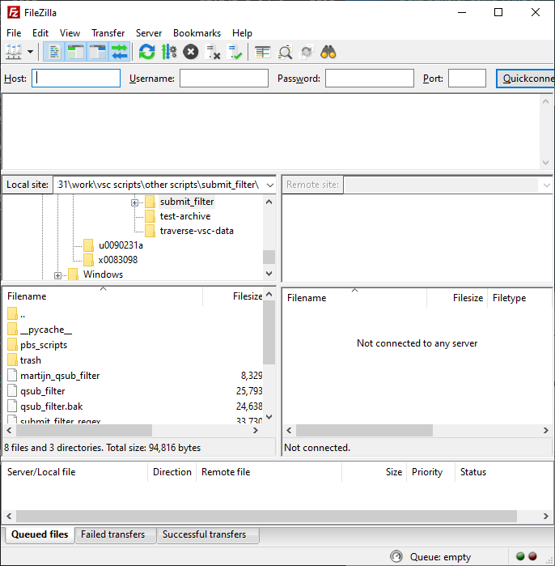
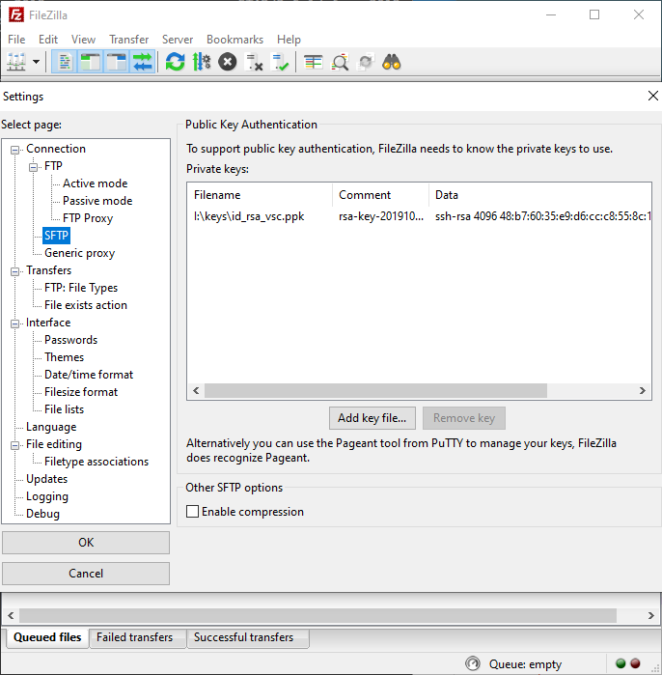
File transfer
1
Edit -> Settings
2
4
3
136

Slide 137
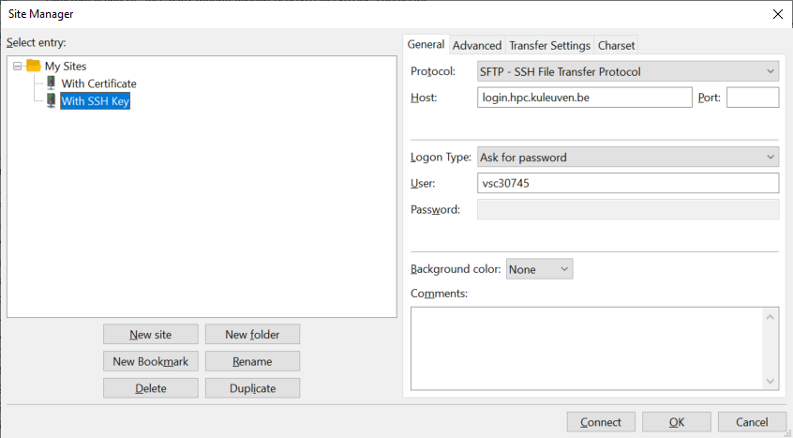
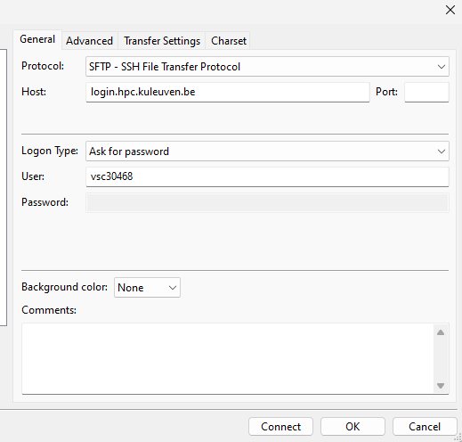
File transfer
6
7
8
5
9
137

Slide 138
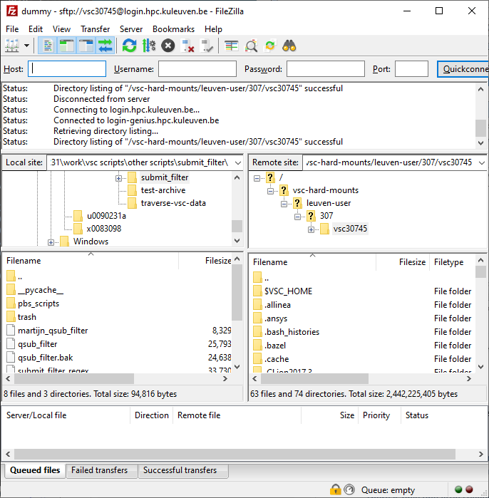
For convenience, you’d better bookmark your data and scratch folders!
Instead, go to your $VSC_DATA folder, e.g. /data/leuven/399/vsc39934
Your local machine (e.g. laptop)
Your VSC storage (e.g. $VSC_DATA, $VSC_SCRATCH). Note: by default you arrive at your own $VSC_HOME. Copy nothing there!
138

Slide 139

Globus
Transfer, share and search within data
Schedule and resume (large) transfers
Fully supported by all VSC sites (available on Tier-2 and Tier-1)
Web-interface
Workflow: Define “endpoint” on the source Define “endpoint” on the destination Transfer between endpoints
Existing endpoints: Tier-2: home/data/scratch storages Tier-1: data/scratch
139

Slide 140
Open Ondemand

Slide 141

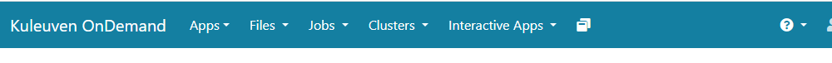
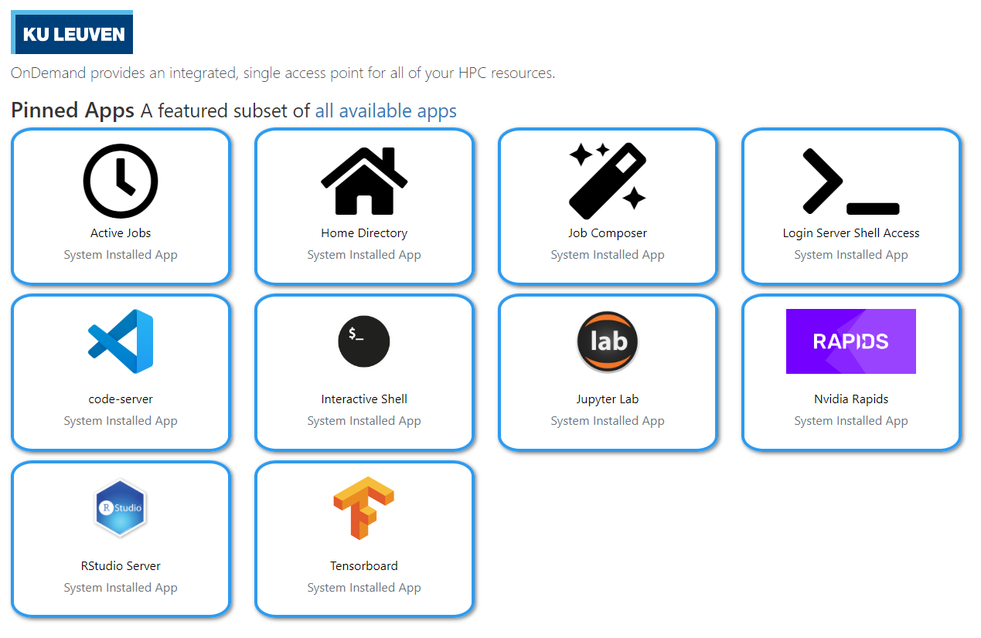
Open OnDemand
Access clusters via web browser
https://ondemand.hpc.kuleuven.be
Login via KULeuven MFA
File browser
Interactive apps + integrated shell
Create, start and monitor jobs
Develop, compile and test your code
VSCode editor
JupyterLab, Rstudio, MATLAB, ParaView and Tensorboard
💡
Please close your interactive sessions, when you don’t actively use it!
141

Slide 142

Open OnDemand
Access your VSC storage
Use “Files” menu to access your VSC_HOME and VSC_DATA
VSC_SCRATCH is not available
File/Folder Management
OK to transfer small files/folders
Open any (sub)folder in terminal (new window)
Deleted files/folders could be retrieved from (hourly, daily, weekly) snapshots
142

Slide 143
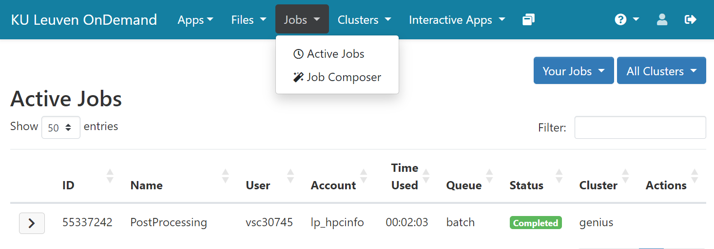
Open OnDemand
Monitor/manage all your jobs
143

Slide 144
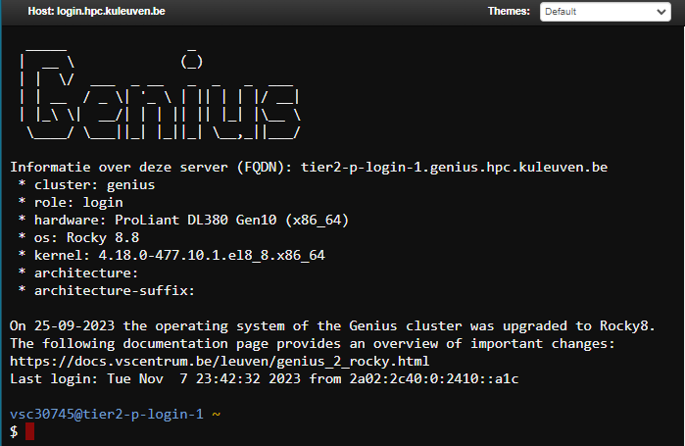
Open OnDemand: Login Server Shell Access
Login Shell
Start shell in a new browser tab
You land on Genius Accessing wICE goes via Genius login
You land on your VSC_HOME cd to data/scratch/staging immediately
Do NOT compute on the login nodes
Try: $ sam-balance $ myquota
144

Slide 145
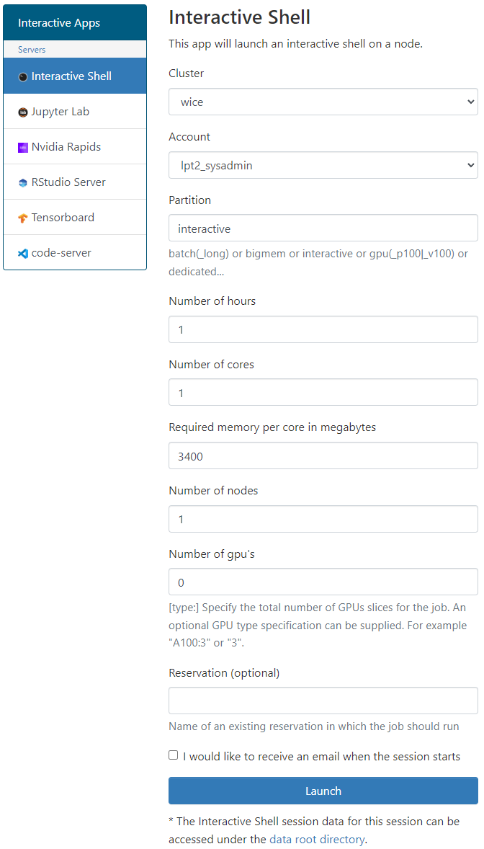
Open OnDemand: Interactive Shell
Interactive Shell
Start shell as a job (on a compute node)
Recommended to: Install your own software (in VSC_DATA) Test/run your program interactively Debug a program
Choose the relevant cluster, partition and resources (core, memory, GPU)
145

Slide 146
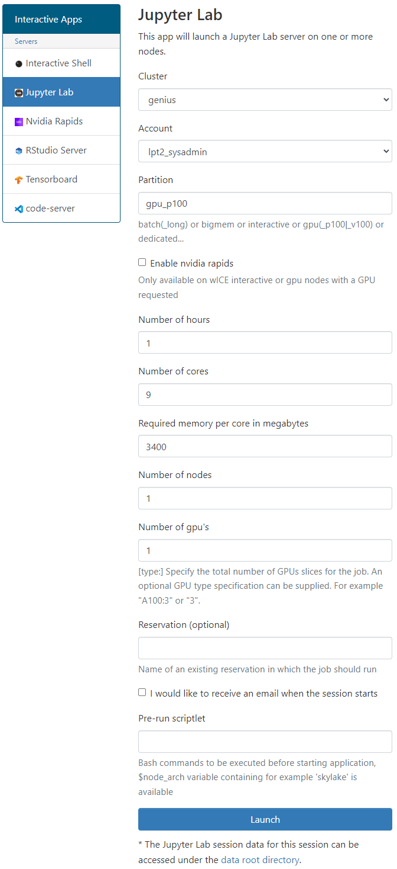
Open OnDemand: Jupyter Lab
Jupyter Lab
Create a notebook as a job (on a compute node)
Best practice to: pre/post-processing your data prototyping add figures and text for pedagogical purposes
Choose the relevant cluster, partition and resources (core, memory, GPU)
Extensions are not supported (for now)
User your own Python/R kernels (next slide)
146

Slide 147
Open OnDemand: Custom R/Python Kernels
My Kernels
Default R/Python kernels are old and limited
You can create a miniconda env and add it to your OnDemand kernels
Step 1: Miniconda
Start an Interactive shell
Go to your data folder $ cd ${VSC_DATA}
Download miniconda $ wget https://repo.continuum.io/miniconda/Miniconda3-latest-Linux-x86_64.sh
Install miniconda into your data folder $ bash Miniconda3-latest-Linux-x86_64.sh –b –p $VSC_DATA/miniconda3
Permanenly add the path to miniconda to your ~/.bashrc $ echo 'export PATH="${VSC_DATA}/miniconda3/bin:${PATH}" ' >> ~/.bashrc
147

Slide 148
Open OnDemand: Custom R/Python Kernels
Step 2: New Environment
Create a new environment <env_name> with all packages you need, e.g. $ conda create -–name=<env_name> numpy scipy … Enable your new environment $ source activate <env_name> Add the ipykernel package $ conda install –c conda-forge ipykernel
Step 3: Register Your Kernel
$ python –m ipykernel install –prefix=~/.local --name <env_name>
Start a new Jupyter Lab session, and the new kernels must be there
148

Slide 149
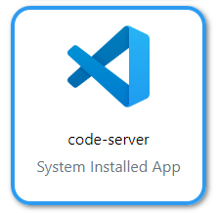
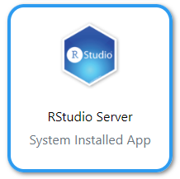

Open OnDemand: Other tools
Start Visual Studio Code server as a job.
Develop, deploy and debug your workflow directly on HPC.
Using interactive partition on wICE is free of charge, and is relevant here.
Supports many languages + Github integration.
Start R IDE as a job.
Install your own packages in $VSC_DATA.
Track machine learning metrics and visualize data during the workflow.
You need to provide a log folder.
149

Slide 150
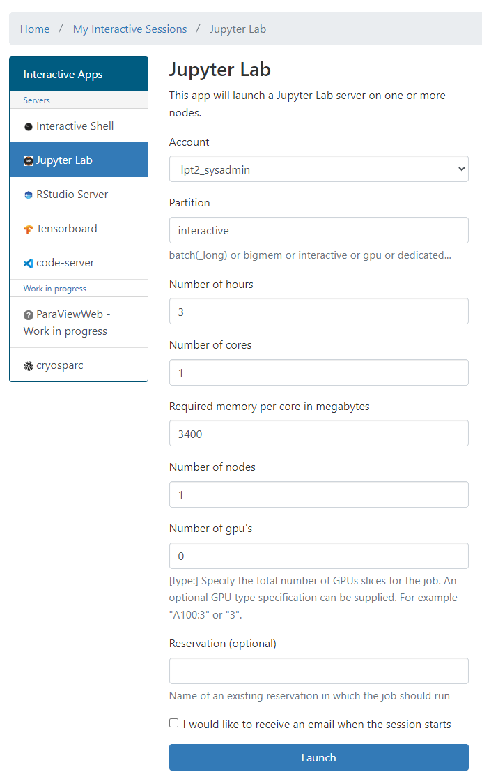
Open OnDemand: Resources
E.g. to start a Jupyter Notebook
Pick a valid Slurm credit account
Default partition: batch interactive: Max 8 cores, 1 GPU (shard), 16 hr
Default resources: 1 core, 1 hour, 3400MB RAM, no GPU
(At the moment) you cannot use scratch and staging
lp_myproject
150

Slide 151
Software Stack

Slide 152
Software: Available Modules
OS: Rocky Linux 8.x
Toolchains:
Intel (icc, icpc, ifort; Intel MPI; Intel MKL)
FOSS (gcc, g++, gfortran; OpenMPI; ScaLAPACK, OpenBLAS, FFTW)
Toolchain year on Genius from 2018a; on wICE from 2021a
Note: Never mix FOSS and Intel compilers (gives dependency conflict)
Command | Remark
module av | List all available modules
module av Python | List all Python-related modules
module spider Python | Get more info
module load Python/3.6.4-intel-2018a | Load a specific module
module list | List all loaded modules and their dependencies
module unload Python/3.6.4-intel-2018a | Unload a module (but dependencies still stay)
module purge | Remove all modules from your work session

Slide 153
Software: Your Specific Needs
You can always install your desired software in your $VSC_DATA Use Intel or FOSS toolchains
Compile your code on a compute node (with interactive job)
If you cannot, ask us for help
Specific Python/R packages is managed by users via conda
Read more about Python Package Management
Read more about R Package Management

Slide 154
Linux File System
Source: http://linuxsuperuser07.blogspot.be/2011/09/rhel-6-file-system.html

Slide 155
Directory structure
Location of installed modules
Location of $VSC_HOME directories
Location of $VSC_DATA directories
/
Location of $VSC_SCRATCH directories
/boot
/dev
/proc
/local_scratch
/apps
/user
/data
/scratch
……..
……..
antwerpen
brussel
gent
leuven
antwerpen
brussel
gent
leuven
haswell
ivybridge
skylake
300
304
317
2018a
2019a
2019b
vsc30400
vsc30XXX
vsc30499
……..
……..

Slide 156
Directory structure
Location of installed modules
Location of $VSC_HOME directories
Location of $VSC_DATA directories
/
Location of $VSC_SCRATCH directories
/boot
/dev
/proc
/local_scratch
/apps
/user
/data
/scratch
……..
……..
antwerpen
brussel
gent
leuven
antwerpen
brussel
gent
leuven
haswell
ivybridge
skylake
300
304
317
2018a
2019a
2019b
vsc30400
vsc30XXX
vsc30499
……..
$VSC_HOME

Slide 157
Directory structure
Location of installed modules
Location of $VSC_HOME directories
Location of $VSC_DATA directories
/
Location of $VSC_SCRATCH directories
/boot
/dev
/proc
/local_scratch
/apps
/user
/data
/scratch
……..
……..
antwerpen
brussel
gent
leuven
antwerpen
brussel
gent
leuven
haswell
ivybdridge
skylake
300
304
317
2018a
2019a
2019b
vsc30400
vsc30XXX
vsc30499
……..
$VSC_DATA

Slide 158
Directory structure
Location of installed modules
Location of $VSC_HOME directories
Location of $VSC_DATA directories
/
Location of $VSC_SCRATCH directories
/boot
/dev
/proc
/local_scratch
/apps
/user
/data
/scratch
……..
……..
antwerpen
brussel
gent
leuven
antwerpen
brussel
gent
leuven
haswell
ivybridge
skylake
300
304
317
2018a
2019a
2019b
vsc30400
vsc304XX
vsc30499
……..
$VSC_SCRATCH

Slide 159
Directory structure
Location of installed modules Genius
Path on Genius:
/apps/leuven/rocky8/skylake/2021a/software/Python/3.9.5-GCCcore-10.3.0
/
modules
logs
software
/boot
/dev
/proc
/local_scratch
/apps
/opt
GCC
matlab
Python
antwerpen
brussel
gent
leuven
3.9.5-GCCcore-10.3.0
3.10.8-GCCcore-10.3.0-bare
rocky8
bin
include
lib
cascadelake
icelake
skylake
cython
python
pip
2018a
2019b
2021a
Location of python (from 3.9.5-GCCcore-10.3.0)

Slide 160
What was I doing???
Not to loose your job after closing your laptop:
Use NX GUI connection
Use command line + tmux
Start session: $ tmux new –s test
Detach session: Ctrl+b+d (safe to go)
List session: $ tmux ls
Reattach session: $ tmux a -t test
Exit screen session (within tmux): $ exit

Slide 161
What was I doing???
Manage Windows and Session Tabs
Ctrl+B C | Create window
Ctrl+B W | List Windows
Ctrl+B N | Next window
Ctrl+B P | Previous window
Ctrl+B F | Find window
Ctrl+B , | Name window
Ctrl+B & | Kill window

Slide 162
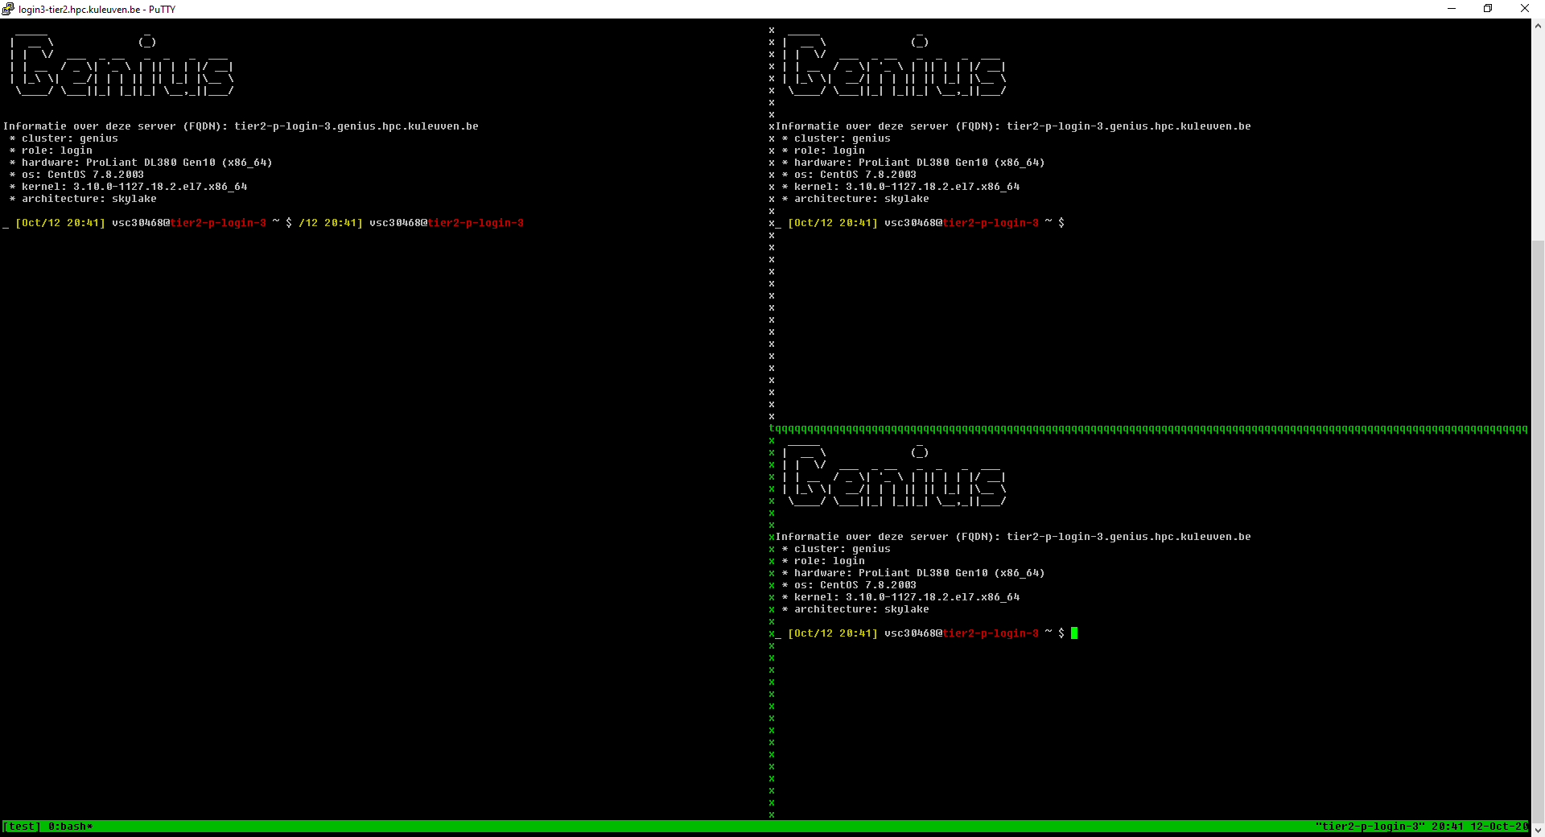
What was I doing???
Panes/splits
Ctrl+B % | Vertical split
Ctrl+B " | Horizontal split
Ctrl+B O | Swap panes
Ctrl+B Q | Show pane numbers
Ctrl+B X | Kill pane
Ctrl+B Arrow Keys | Move to pane

Slide 163
What was I doing???
Not to loose your job after closing your laptop:
Use command line + screen
Start session: $ screen –S test
Detach session: Ctrl+a+d (safe to go)
List session: $ screen -ls
Reattach session: $ screen –r test
Exit screen session (within screen): $ exit

Slide 164
Screen
Create new window: ctrl-a c
Go to previous/next window: ctrl-a p/n
Go to window by number: ctrl-a <window-nr>
Show current windows, move: ctrl-a ", <window-nr>
Close window: ctrl-a K
Detach screen: ctrl-a d
List current screen sessions: $ screen -ls
Re-attach to session: $ screen -r <session-id>
Kill dead session: $ screen -wipe
Get help: ctrl-a ?
Monitor for activity: ctrl-a M (same to stop monitoring)
Monitor for inactivity: ctrl-a _ (same to stop monitoring)

Slide 165
Screen
Split screen horizontally: ctrl-a S
Split screen vertically: ctrl-a |
Go to next screen region: ctrl-a <tab>
Remove current region: ctrl-a X
Remove all but current region: ctrl-a Q
Enter copy mode: ctrl-a [
Paste: ctrl-a ]
Dump window contents to file: ctrl-a h
Enable logging: ctrl-a H
Useful .screenrc file that eliminates some of screen's nuisances:
# Turn off that annoying start up message
startup_message off
# Increase scroll back buffer to a more useful number of lines
defscrollback 10000

Slide 166
Screen - settings
In your .bashrc file
case ${TERM} in
xterm)
echo "Hello terminal!!!"
;;
screen)
echo "Hello screen!!!"
;;
esac

Slide 167
Aliasing
Alias – Alternate name for a command(s)
You can be inventive with it, but be careful
If you log out from bash, your aliases will be purged!
To define an alias permanently, put it in your .bashrc
E.g. Image, your jobs always store the results in your scratch folder. So, you want an easy way to copy them to your data folder: alias backup=“cp –r $VSC_SCRATCH/results $VSC_DATA/backup”
To disable an alias, do: unalias backup

Slide 168
Alias and Unalias
alias newname=oldname
eg. alias copy=cp
Then we can use copy in the same way we use cp command
eg. copy file1 file2 //copies content of file1 to file2
To remove alias use unalias command
unalias copy
After this we cannot use copy to perform copying function

Slide 169
Alias
Shells let you define command aliases: shortcuts for commands you use very frequently.
Examples
alias la='ls -la' Useful to always run commands with default arguments.
alias rmi='rm -i' Useful to make rm always ask for confirmation.
alias data='cd /data/leuven/304/vsc30XXX' Useful to replace very long and frequent commands.
alias schck='. /home/mag/env/chck.sh' Useful to set an environment in a quick way (. is a shell command to execute the content of a shell script).

Slide 170
which command
Before you run a command, which tells you where it is found
which ls alias ls='ls --color=auto' /usr/bin/ls
which alias
/usr/bin/alias
which help
/usr/bin/which: no help in (/usr/local/bin:/usr/local/sbin:/usr/bin:/usr/sbin:/bin:/sbin:/home/mag/.local/bin:/home/mag/bin)

Slide 171
~/.bashrc file
~/.bashrc Shell script read each time a bash shell is started (login, or when the job starts on a compute node)
You can use this file to define
Your default environment variables (PATH, EDITOR...).
Your aliases.
Your prompt (see the bash manual for details).
A greeting message.
Do NOT put “module load” in your .bashrc. It creates conflicts

Slide 172
bash configuration Files
bash has two different login files.
.bashrc gets read when you open a local shell on a machine
.bash_profile only gets read if and only if you login from a remote machine. Note that .bash_profile itself reads in your .bashrc file as well.
If you want aliases to be executed regardless, then you should put them in the .bashrc file.
On the cluster please edit only .bashrc file – in case of problem we can always allow you access thanks to correct .bash_profile

Slide 173
~/.bash_profile
This is how your ~/.bash_profile looks like
Tip: never touch it
~/.bash_profile
# File: .bash_profile
# Get the aliases and functions
# Get whatever is in your
# .bashrc config file
if [ -f ~/.bashrc ]; then
. ~/.bashrc
fi

Slide 174
# File: .bashrc #
# Description: A default .bashrc
###Source global defs ###
if [ -f /etc/bashrc ]; then
. /etc/bashrc
fi
###set the prompt ###
# uncomment out only one
# this is hostname and time
PS1="\h-(\@): "
# this is hostname and
# history number
#PS1="\h-(\!)# "
# this is hostname and
# working directory
#PS1="\h-(\w)# "
# this is hostname and
# shortened working
# directory
#PS1="\h-(\W)# "
### path manipulation ###
# add ~/bin to the path,
# cwd as well
PATH="$PATH:$HOME/bin:./“
### env variables ###
# make sure that you
# change this to your
# username
MAIL="/afs/umbc.edu/users/u/s/username/Mail/inbox“
export PATH
unset USERNAME
### User-specific aliases
### and functions ###
alias rm="rm -i"

Slide 175
Environment Variables
Use the env command to see all environment variables
set/export to see all shell variables
Set or change environment variables from the command-line: new values last only for current login session.
sh/bash/ksh set: NEW_VARIABLE=newvalue append: OLD_VARIABLE=$OLD_VARIABLEnewvalue prepend: OLD_VARIABLE=newvalue$OLD_VARIABLE
add: OLD_VARIABLE=${OLD_VARIABLE}:newvalue
export OLD_VARIABLE
The order decides where system checks for command first (important if you have your own version and there is another vesion on the cluster)

Slide 176
Introduction to bash
The bash shell is one of the many shells that are available to you on the VSC nodes.
Almost any installation of Linux defaults to the bash shell.
bash is one of the many GNU.org (http://www.gnu.org) projects.
bash manuals:
A comprehensive online manual is provided at http://www.gnu.org/software/bash/manual/bashref.html
Aliases - http://www.gnu.org/software/bash/manual/bashref.html#Aliases
Controlling the Prompt - http://www.gnu.org/software/bash/manual/bashref.html#Controlling-the-Prompt

Slide 177
Universal customization
Universal .bashrc - written to run on all (relevant) clusters:
case ${VSC_INSTITUTE_CLUSTER} in
wice)
ulimit -c 500000
export LD_LIBRARY_PATH="${HOME}/lib:${LD_LIBRARY_PATH}"
export PATH="${HOME}/bin:${HOME}/sbin:${PATH}"
export EDITOR="/usr/bin/vim"
export PS1=': \u@\[\e[1;31m\]\h\[\e[0m\] \w `date +%H:%M` $'
source ${HOME}/.autoenv/activate.sh
;;
genius)
export EDITOR="/usr/bin/vim"
alias vim="vim -u .vimrc-simple“
export PS1=': \u@\[\e[1;34m\]\h\[\e[0m\] \w `date +%H:%M` $ '
;;
esac

Slide 178
Starting to Compute

Slide 179







Resource Glossary
Cluster: Which machine to use? Genius or wICE?
Nodes: how many compute servers to request?
Cores: how many cores per node to use?
Memory requirement: how much memory each core needs?
Partition: gpu, bigmem, superdome, amd
Walltime: how long to use resources?
Storage: how much storage (data, scratch, etc) the job needs?
Credits: how many compute credits will be consumed?

Slide 180
Default Resources
Cluster: the local machine you are logged into (Genius or wICE)
Nodes: 1
Cores: 1
RAM: depends on which node(s) you use
Partition: batch
Walltime: 1 hour
Storage: no default
Credits: no default

Slide 181
Serial Application (1 process on 1 core)
Single Process
One node
Multi-Core Appl. (N threads on N cores from 1 node)
Thread Group
Process Group
Distributed Appl. (many processes on
multiple cores/nodes)

Slide 182
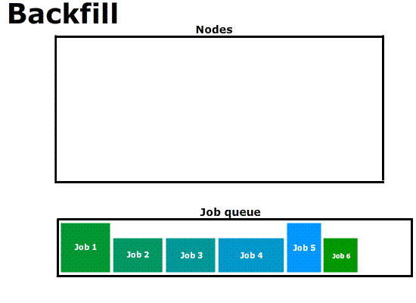
cores
time

Slide 183



Interactive Job
Compute nodes
Login node
srun …
Batch Job
Compute nodes
Login node
sbatch script.slurm

Slide 184
Interactive Job on wICE
Request interactive job
Project Name for Compute Credits
For special hardware or queue
Target cluster
$ srun --account=<project name> --partition=interactive –-clusters=wice \ --nodes=1 --ntasks=4 --time=01:00:00 --pty bash -l
-
-
Number of nodes
Number of processes or cores
Max. Runtime
Interpret with Bash
Remark
Specifying <project name> for credits is mandatory, e.g.: –A lp_hpcinfo
Implicit defaults for an interactive job on wICE are: -n 1, -t 01:00:00, --mem-per-cpu=2000M

Slide 185
Command | Purpose
$ sbatch ... | Submit a batch job
$ srun ... | Submit an interactive job
$ scancel --cluster=wice <JobID> | Cancel a specific pending or running job
$ scontrol show job --clusters=wice <JobID> $ slurm_jobinfo <JobID> | Detailed job info (very useful to diagnose issues)
$ squeue --clusters=wice --long | Status of all recent jobs
$ squeue --clusters=wice --start | Give a rough estimate of start time
$ sinfo --clusters=wice | Info about the state of available partitions and nodes
$ sacct --clusters=wice --batch --job <JobID> | Show minimal info about a queue or partition (-p)
$ slurmtop $ scontrol --clusters=wice show node <hostname> | Overview of the cluster Get detailed information about the status of a node
$ sam-balance | Overview of all your available credit projects
$ sam-list-allocations | Detailed overview of your credit allocation history

Slide 186
Jobs: Slurm submit options
SLURM | Remarks
--nodes=X --ntasks-per-node=Y --ntasks=X*Y --ntasks=X --cpus-per-task=Y | or or (e.g. Hybrid MPI + OpenMP)
--partition=<partition_name> | Default: "batch" partition
--mem-per-cpu=<size><M> | Min memory per core, e.g. 5000M for Genius
--time=<dd-hh:mm:ss> | e.g. 1-12:30:00
--job-name=<job_name>
--output=<file_template> | STDOUT; defaullt=“slurm-%j.out”
--error=<file_template> | Default: redirect to STDOUT
--mail-type=FAIL,BEGIN,END
--mail-user=<email-address>
--export=<ALL,key=value> | Additional variables to pass to job
--account=<account_name> | Mandatory (credits)
186

Slide 187
Argument Shorthands
Shorthand | Full Argument | Meaning
-A | --account | Slurm account name
-a | --array | Job array range
-M | --clusters | Machine or cluster name
-c | --cpus-per-task | Num cores per task (default=1)
-d | --dependency | Job dependency (after, afterok, afterany, …)
-I | --input | STDIN filename
-e | --error | STDERR filename
-o | --output | STDOUT filename
-t | --time | Maximum walltime
-N | --nodes | Minimum num nodes
-n | --ntasks | Maximum num tasks
-p | --partition | Partition name
Some (not all) of the sbatch, srun and salloc command line arguments have shorthands

Slide 188
Interactive Jobs
Interactive job: 1 core for 1 hour (default) $ srun --clusters=wice --account=lp_hpcinfo --pty /bin/bash -l
Interactive job with X-forwarding $ srun --clusters=wice --account=lp_hpcinfo –x11 --pty /bin/bash -l
Request fraction of a node from interactive partition $ srun --clusters=wice --account=lp_hpcinfo --nodes=1 --ntasks=4 \ --partition=interactive --pty /bin/bash –l
Request a GPU accelerator $ srun --clusters=wice --account=lp_hpcinfo --nodes=1 --ntasks=18 \ --partition=gpu --gpus-per-node=1 --pty /bin/bash -l
To join a running job $ sattach <JobID>.<StepID> # e.g. 55439251.0

Slide 189
Example Slurm Job Script
jobscript.slurm
#!/bin/bash –l
#SBATCH --clusters=wice #SBATCH --account=lp_hpcinfo #SBATCH --nodes=1 #SBATCH --ntasks=4 #SBATCH --mem-per-cpu=3400M #SBATCH --job-name=hpc_workflow #SBATCH --mail-type=BEGIN,END,FAIL #SBATCH --mail-user=my.name@kuleuven.be
module load intel/2021a module load Python/3.9.5-GCCcore-10.3.0
which python3
cd $VSC_SCRATCH/projects/simulations
cp –r $VSC_DATA/input_data .
python modelling.py
cp –r output_data $VSC_DATA
rm –rf ./input_data ./output_data
Shebang
Resource List
Module load(s)
Move data
Execute commands
Move data
189

Slide 190
Job Script
Batch Workload
#!/bin/bash -l
…
Submit the job to the batch server
Receive a unique JobID
Error and output files
Command Line
$ sbatch simulation.slurm
JobID
Submitted batch job 60042478 on cluster wice
stderr, stdout
$ ls *.out slurm-60042478.out

Slide 191
Output File
STDOUT + STDERR
STDERR and STDOUT are by default redirected to a single file:
slurm-<JobID>.out
Contains job info, all errors and warnings, and printouts
Always study it
Address all warnings and errors (if you can)
Typical error examples …
$ ls slurm-*.out slurm-60042478.out
Out of Memory
slurmstepd: error: Detected 1 oom-kill event(s). Some of your processes may have been killed by the cgroup out-of-memory handler.
Short Walltime
slurmstepd: error: *** JOB 60042478 ON s28c11n2 CANCELLED AT 2023-02-08T10:03:43 DUE TO TIME LIMIT ***
Low Disk Space
IOError: [Errno 122] Disk quota exceeded

Slide 192
Output File
Output File
SLURM_JOB_ID: 60033947
SLURM_JOB_USER: vscXXXXX
SLURM_JOB_ACCOUNT: lp_wice_pilot
SLURM_JOB_NAME: testjob
SLURM_CLUSTER_NAME: wice
SLURM_JOB_PARTITION: batch
SLURM_NNODES: 1
SLURM_NODELIST: m28c30n4
SLURM_JOB_CPUS_PER_NODE: 72
Date: Tue Jan 10 17:02:04 CET 2023
Walltime: 00-01:00:00
==================================
/apps/leuven/rocky8/icelake/2021a/softwar
e/intel-compilers/2021.2.0/compile
r/2021.2.0/linux/bin/intel64/icc
cp: cannot stat '/apps/leuven/trai
ning/test': No such file ordirecto
ry
Hello World
Always created
slurm-<job_id>.out
Contains all standard output and error (instead of screen)
Always study it
Standard Output and Error channels can be redirected to other files: #SBATCH --output … #SBATCH --error …
Resource Summary
Stdout
stdout
$ ls slurm-*.out slurm-60041238.out

Slide 193
Output File
Example
$ scontrol show job --clusters=wice 60049330
JobId=60049330 JobName=f70.slurm
UserId=vsc3…(253…) GroupId=vsc3…(253…) Account=lp_my_project QOS=lp_my_project
JobState=PENDING Reason=QOSGrpBillingMinutes SubmitTime=2023-02-16T00:24:58 EligibleTime=2023-02-16T00:24:58 Partition=batch NodeList= NumNodes=4-4 NumCPUs=288 NumTasks=288 CPUs/Task=1
TRES=cpu=288,mem=979200M,node=4,billing=733 MinCPUsNode=72 MinMemoryCPU=3400M WorkDir=/vsc-hard-mounts/leuven-data/3../vsc3…/Odonate_SOM
StdErr=/vsc-hard-mounts/leuven-data/3../vsc3…/Odonate_SOM/slurm-60049330.out
StdIn=/dev/null
StdOut=/vsc-hard-mounts/leuven-data/3../vsc3…/Odonate_SOM/slurm-60049330.out
Diagnosis
Why is my job in pending/hold state? Check out the “Reason” on Slurm docs: https://slurm.schedmd.com/resource_limits.html

Slide 194
Interactive Partitions
Accessible via command line and Open OnDemand
To quickly compile, test, debug your (parallel) application
To pre-/post-process your data and make visualizations
Short queue time
12 nodes on Genius: 36 cores/node, 192 GB mem
4 nodes on wICE: 64 cores/node, 512 GB mem, 1 GPU (=7 GPU instances)
Max resource per user: 8 cores, 1 GPU instance, 16 hour walltime
Free of charge
Interactive Job
$ srun --account=lp_myproject --clusters=wice \
--partition=interactive --nodes=1 --time=16:00:00 \
--gpus-per-node=1 --pty bash -l

Slide 195
Debugging Partitions
Accessible via command line and Open OnDemand
Quickly test if your (parallel) application works
Short queue time
Only one job at a time, max walltime: 1 hr
Cluster | Partition | Resources
Genius | batch_debug | 2x Cascadelake
 | gpu_p100_debug | 1x Skylake node (4x P100 GPUs)
wICE | interactive | 4x Icelake (1x A100 GPU)
 | gpu_a100_debug | 1x Icelake (4x A100 GPUs)

Slide 196
Demo: Test yourself

Slide 197
Basics
Request membership to lp_hpcinfo group (account.vscentrum.be)
Login via OpenOnDemand: www.ondemand.hpc.kuleuven.be Features: File transfer, File editor, interactive apps, Jobs’ overview
Check disk quota: $ myquota
Check the credits $ sam-balance and $ sam-list-allocations
Software modules: $ module {avail|list|load|unload|purge}

Slide 198
Demo/test yourself
Copy training material /apps/leuven/training/HPC_intro/ to your $VSC_DATA
Submit cpujob to the cluster
List all your jobs squeue -M wice
Check the information about the cpujob slurm_jobinfo -M wice <job_ID>
Modify the mpi.slurm script to request 1 node, 72 cores for 30 minutes and get the notification about job start/end by e-mail
Check the status of all the jobs
While the job is running get the information about the node slurm_jobinfo...

Slide 199
Demo - monitoring
Submit an interactive job
Run your program on a compute node
Open a new terminal and ssh to a compute node
Check the resources usage (htop)

Slide 200
Command | Purpose
$ sbatch ... | Submit a batch job
$ srun ... | Submit an interactive job
$ scancel --cluster=wice <JobID> | Cancel a specific pending or running job
$ scontrol show job --cluster=wice <JobID> $ slurm_jobinfo <JobID> | Detailed job info (very useful to diagnose issues)
$ squeue --cluster=wice --long | Status of all recent jobs
$ squeue --cluster=wice --start | Give a rough estimate of start time
$ sinfo --cluster=wice | Info about the state of available partitions and nodes
$ sacct --cluster=wice --batch --job <JobID> | Show minimal info about a queue or partition (-p)
$ slurmtop $ scontrol --cluster=wice show node <hostname> | Overview of the cluster Get detailed information about the status of a node
$ sam-balance | Overview of all your available credit projects
$ sam-list-allocations | Detailed overview of your credit allocation history

Slide 201
demo – conda installation
Start an interactive job on Genius or wICE srun –M genius –A <account> -n 1 --pty /bin/bash -l
Install miniconda in your $VSC_DATA directory
$ wget https://repo.continuum.io/miniconda/Miniconda3-latest-Linux-x86_64.sh
$ bash Miniconda3-latest-Linux-x86_64.sh –b –p $VSC_DATA/miniconda3
Add a PATH to conda:
$ export PATH="${VSC_DATA}/miniconda3/bin:${PATH}"
Check if conda is added to your $PATH ($ which conda)
Add it to $PATH in your .bashrc
$ echo 'export PATH="${VSC_DATA}/miniconda3/bin:${PATH}" ' >> .bashrc

Slide 202
demo – conda usage
Create a conda environment including Jupyter
$ conda create -n science jupyter numpy scipy
Activate this environment
$ source activate science
Add matplotlib package to this environment
$ conda install matplotlib
Return to original environment
$ conda deactivate

Slide 203
Questions
Helpdesk: hpcinfo@kuleuven.be or https://admin.kuleuven.be/icts/HPCinfo_form/HPC-info-formulier
VSC web site: http://www.vscentrum.be/
VSC documentation: https://docs.vscentrum.be/en/latest/
VSC agenda, training sessions, events (User Day): https://www.vscentrum.be/vsctraining
Systems status page: http://status.vscentrum.be

Slide 204

Start with VSC
https://hpcleuven.github.io/HPC-intro/

Slide 205
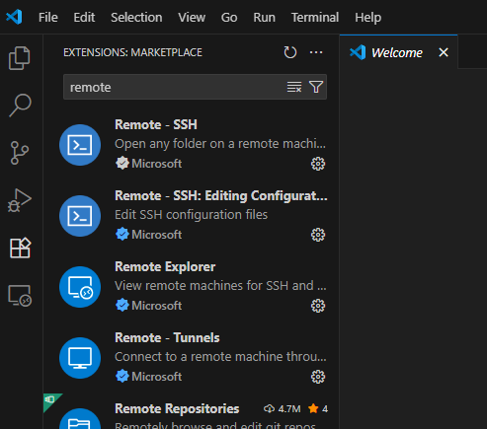
VS Code
Install Remote-SSH extension

Slide 206

VS Code
Install Remote-SSH extension
Click on the connection sign (bottom left corner)

Slide 207

VS Code
Install Remote-SSH extension
Click on the connection sign (bottom left corner)
Click on Connect to Host (top of the window)

Slide 208



VS Code
Install Remote-SSH extension
Click on the connection sign (bottom left corner)
Click on Connect to Host (top of the window)
Click on +Add New SSH Host
Fill in connection details vsc3XXXX@login.hpc.kuleuven.be and press enter
Confirm creating/updating configuration file
Connection is saved

Slide 209

VS Code
Click again on the connection sign (bottom left corner)
Select login node from the list
New windows will open
Click on details (in blue, bottom right corner)

Slide 210

VS Code
Click again on the connection sign (bottom left corner)
Select login node from the list
New windows will open
Click on details (in blue, bottom right corner)
You will see firewall link to open and confirm connection

Slide 211

VS Code
Click again on the connection sign (bottom left corner)
Select login node from the list
New windows will open
Click on details (in blue, bottom right corner)
You will see firewall link to open and confirm connection
Authenticate with MFA
You are all set: you can create/open files on the login node of the cluster

Slide 212


Slide 213


Slide 214

ncview
https://people.sc.fsu.edu/~jburkardt/data/netcdf/netcdf.html
Xming+Enable X11 forwarding
$ module load ncview
$wget https://people.sc.fsu.edu/~jburkardt/data/netcdf/simple_xy.nc
$ ncview simple_xy.nc

